Slide 1

ACCUMULATORS, REPAIR KITS, and ACCESSORIES
Remove the Mysteries of Accumulators for Safe, Efficient Design
Presented for the NFPA, Fluid Power Vehicle Challenge
by Dan Turner, President
GPM Controls
dturner@gpmcontrols.com
gpmcontrols.com

Slide 2
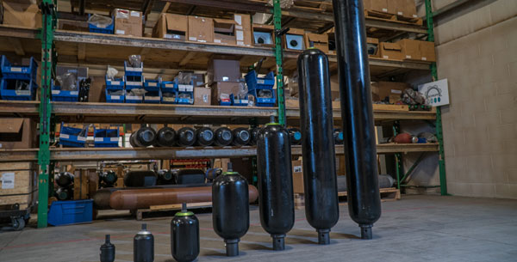
Accumulators… what are they?
An accumulator is to hydraulics as a capacitor is to electronics.
They can both be energy storage devices as well surge suppressors.
ACCUMULATORS, REPAIR KITS, and ACCESSORIES

Slide 3
Accumulators
ACCUMULATORS, REPAIR KITS, and ACCESSORIES
Most modern accumulators are gas-charged, though in earlier years, weight-loaded accumulators were used for energy storage.
Weights were placed on a piston that was inside of a cylinder. This provided a consistent oil pressure from the accumulator.
Gas charged accumulators drop in pressure as they discharge fluid.
Gas charged accumulators have a barrier between the gas and the fluid.

Slide 4
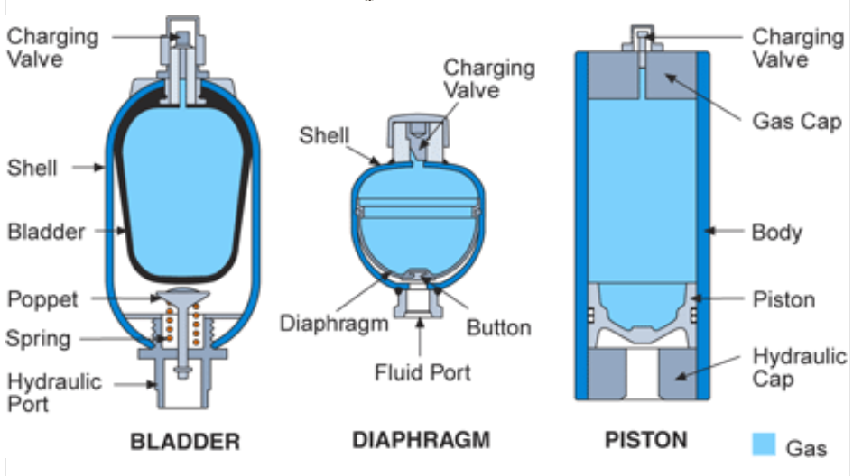
ACCUMULATORS, REPAIR KITS, and ACCESSORIES
The 3 main types of gas-charged accumulators are bladder, diaphragm, and piston. The most common gas used is Nitrogen.

Slide 5
Accumulators
Each type of accumulator has unique features.
One of the critical determining features of which type of accumulator to use is often the cost, though no one style is “best” for all applications.
Accumulators are pressure vessels and are regulated as such by each country of use – not country of manufacture.
The US recognizes ASME certification, Canada is CRN and Europe is CE (PED).
The proper certifications need to be considered prior to ordering.
ACCUMULATORS, REPAIR KITS, and ACCESSORIES

Slide 6
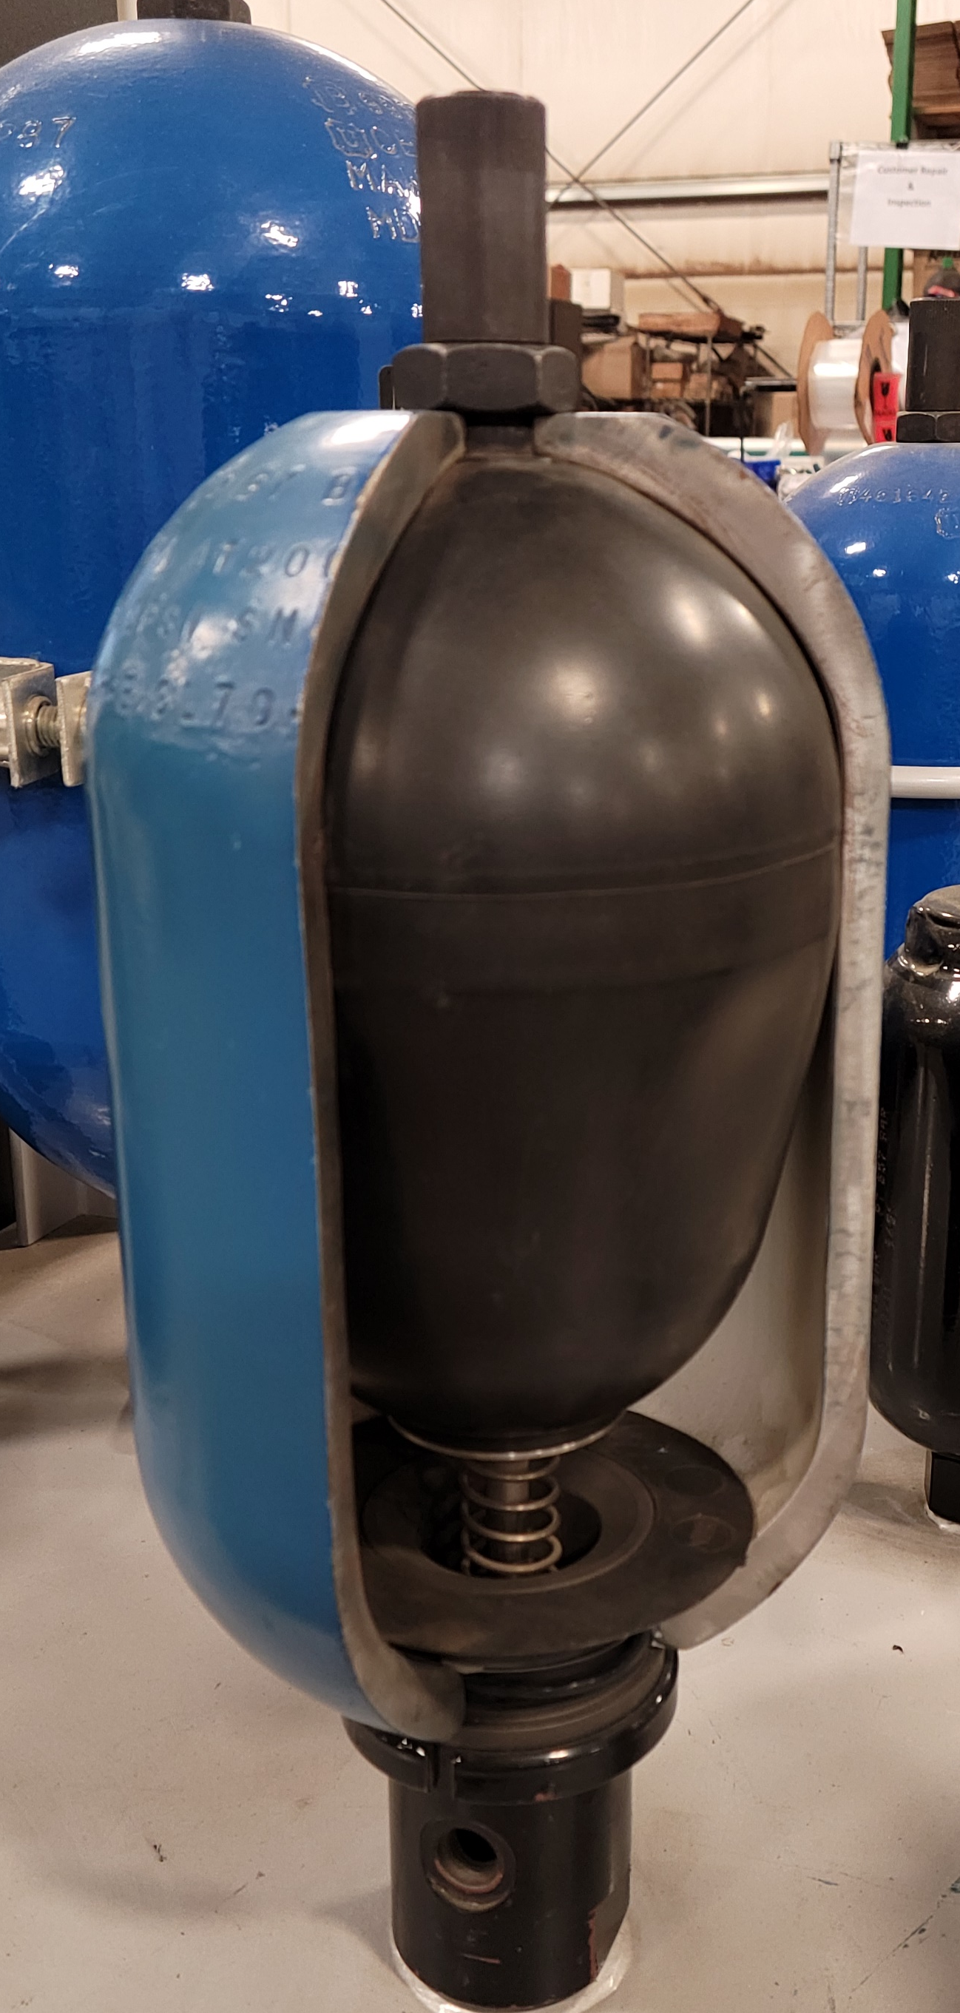
Protective Cap
Gas Valve
ACCUMULATORS, REPAIR KITS, and ACCESSORIES
Bladder Cut-Away
Main Components
Bladder
Shell
Poppet
AER
Oil
Port

Slide 7
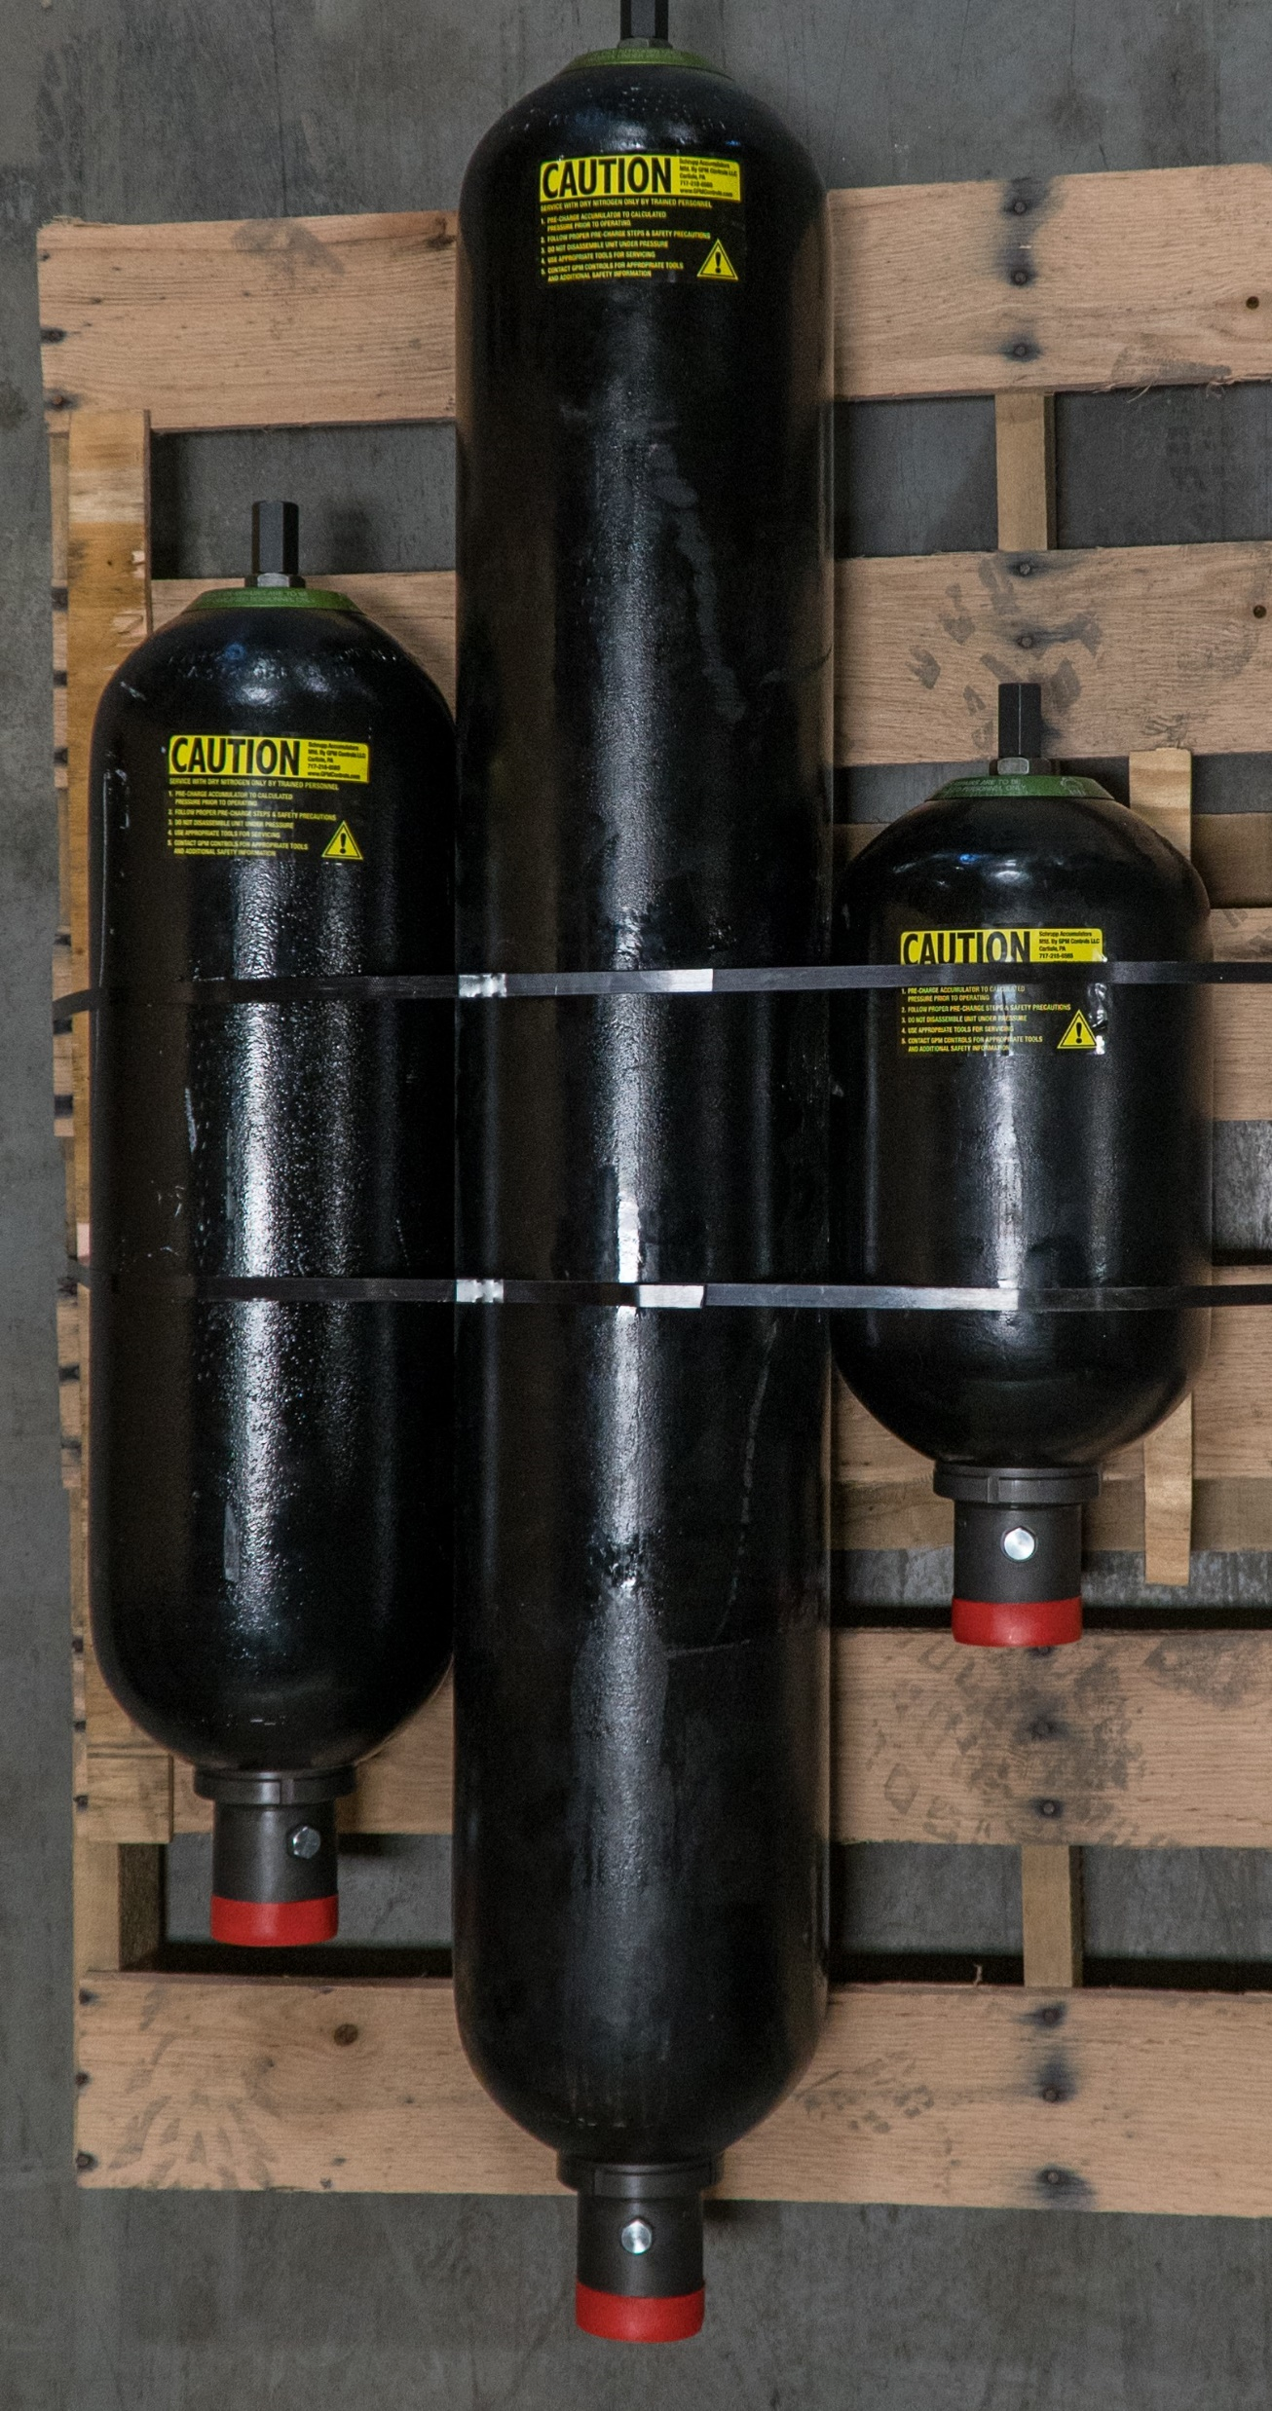
Bladder
Generally, range from 1 pint to 15 gallons.
Repairable.
Readily available.
They have specific sizes, which are commonly:
  1 pint 2 ½ gallon 11 gallon
  1 quart 5 gallon 15 gallon
  1 gallon 10 gallon
ACCUMULATORS, REPAIR KITS, and ACCESSORIES

Slide 8
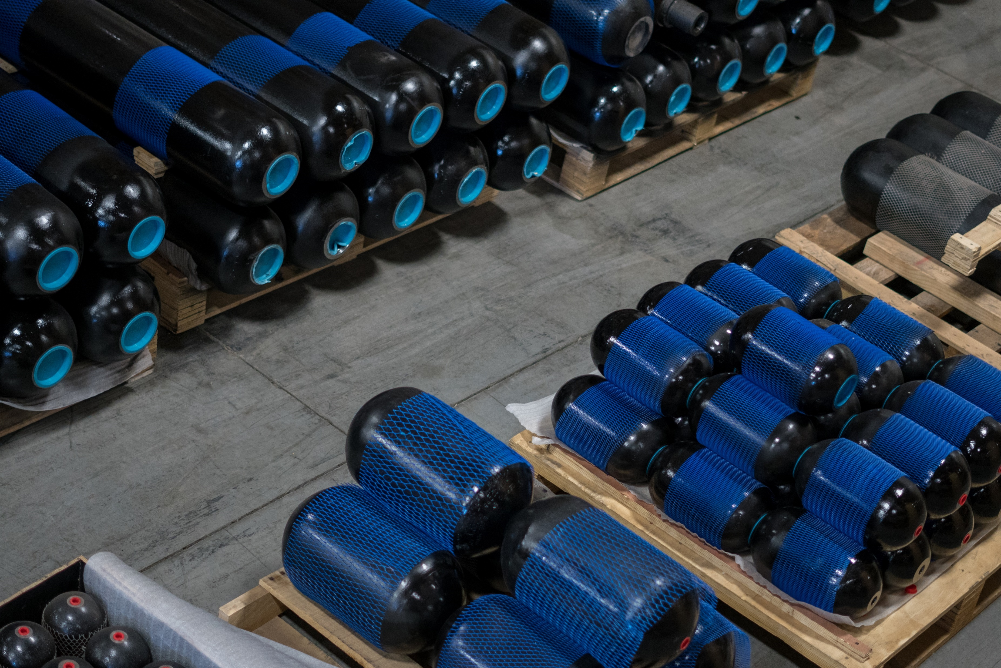
Bladder
Pressure Ratings
ASME pressure ratings – 3000 psi & 5000 psi
ASME VIII Div.1 App.22 is a certification that allows the “3000 psi” to be rated to 4000 psi and the “5000 psi” to be rated to 6000 psi.
ACCUMULATORS, REPAIR KITS, and ACCESSORIES

Slide 9
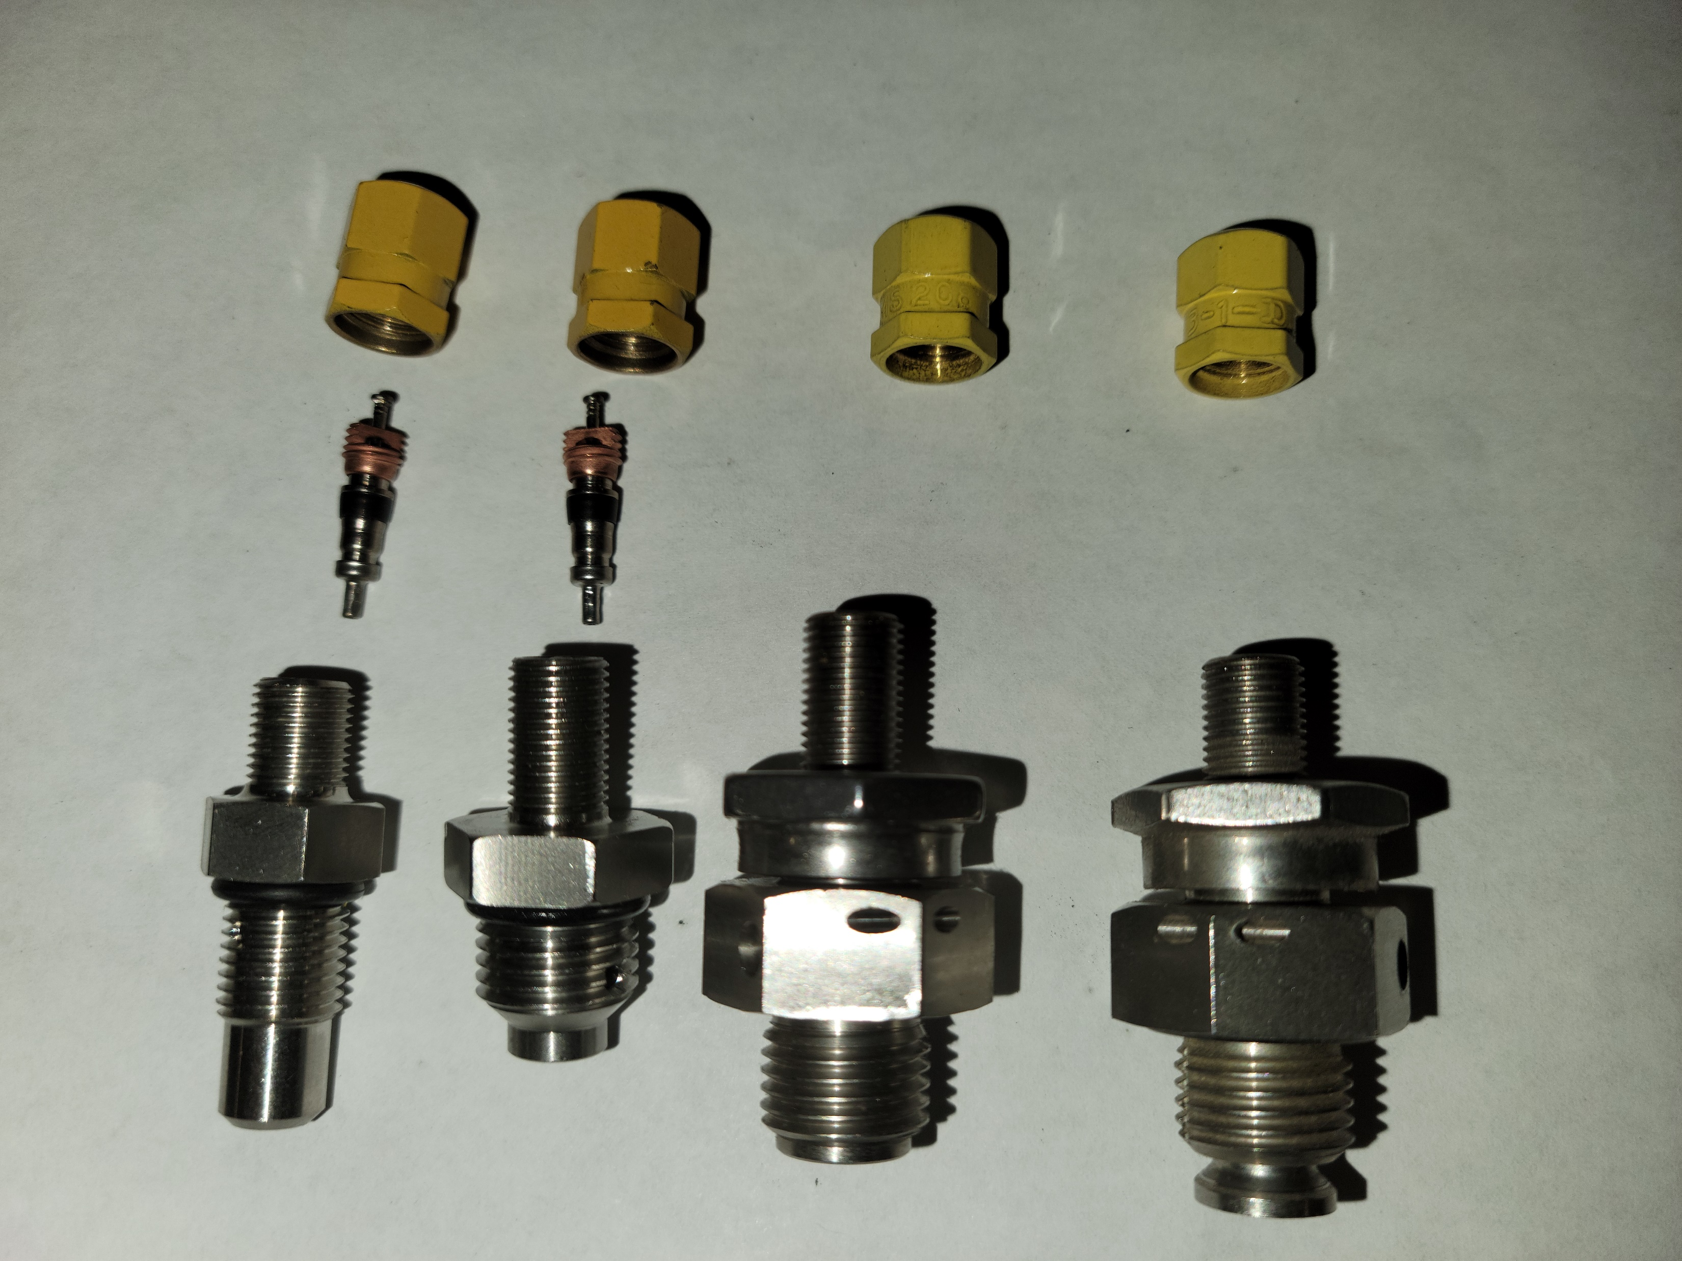
ACCUMULATORS, REPAIR KITS, and ACCESSORIES
Bladder
Pressure Ratings
Gas Valves in the bladder stems
Most are replaceable
3000 psi have an insert
5000 psi have a metal-metal seat
Tops of bladder gas stems are formed differently for the valve seal type

Slide 10
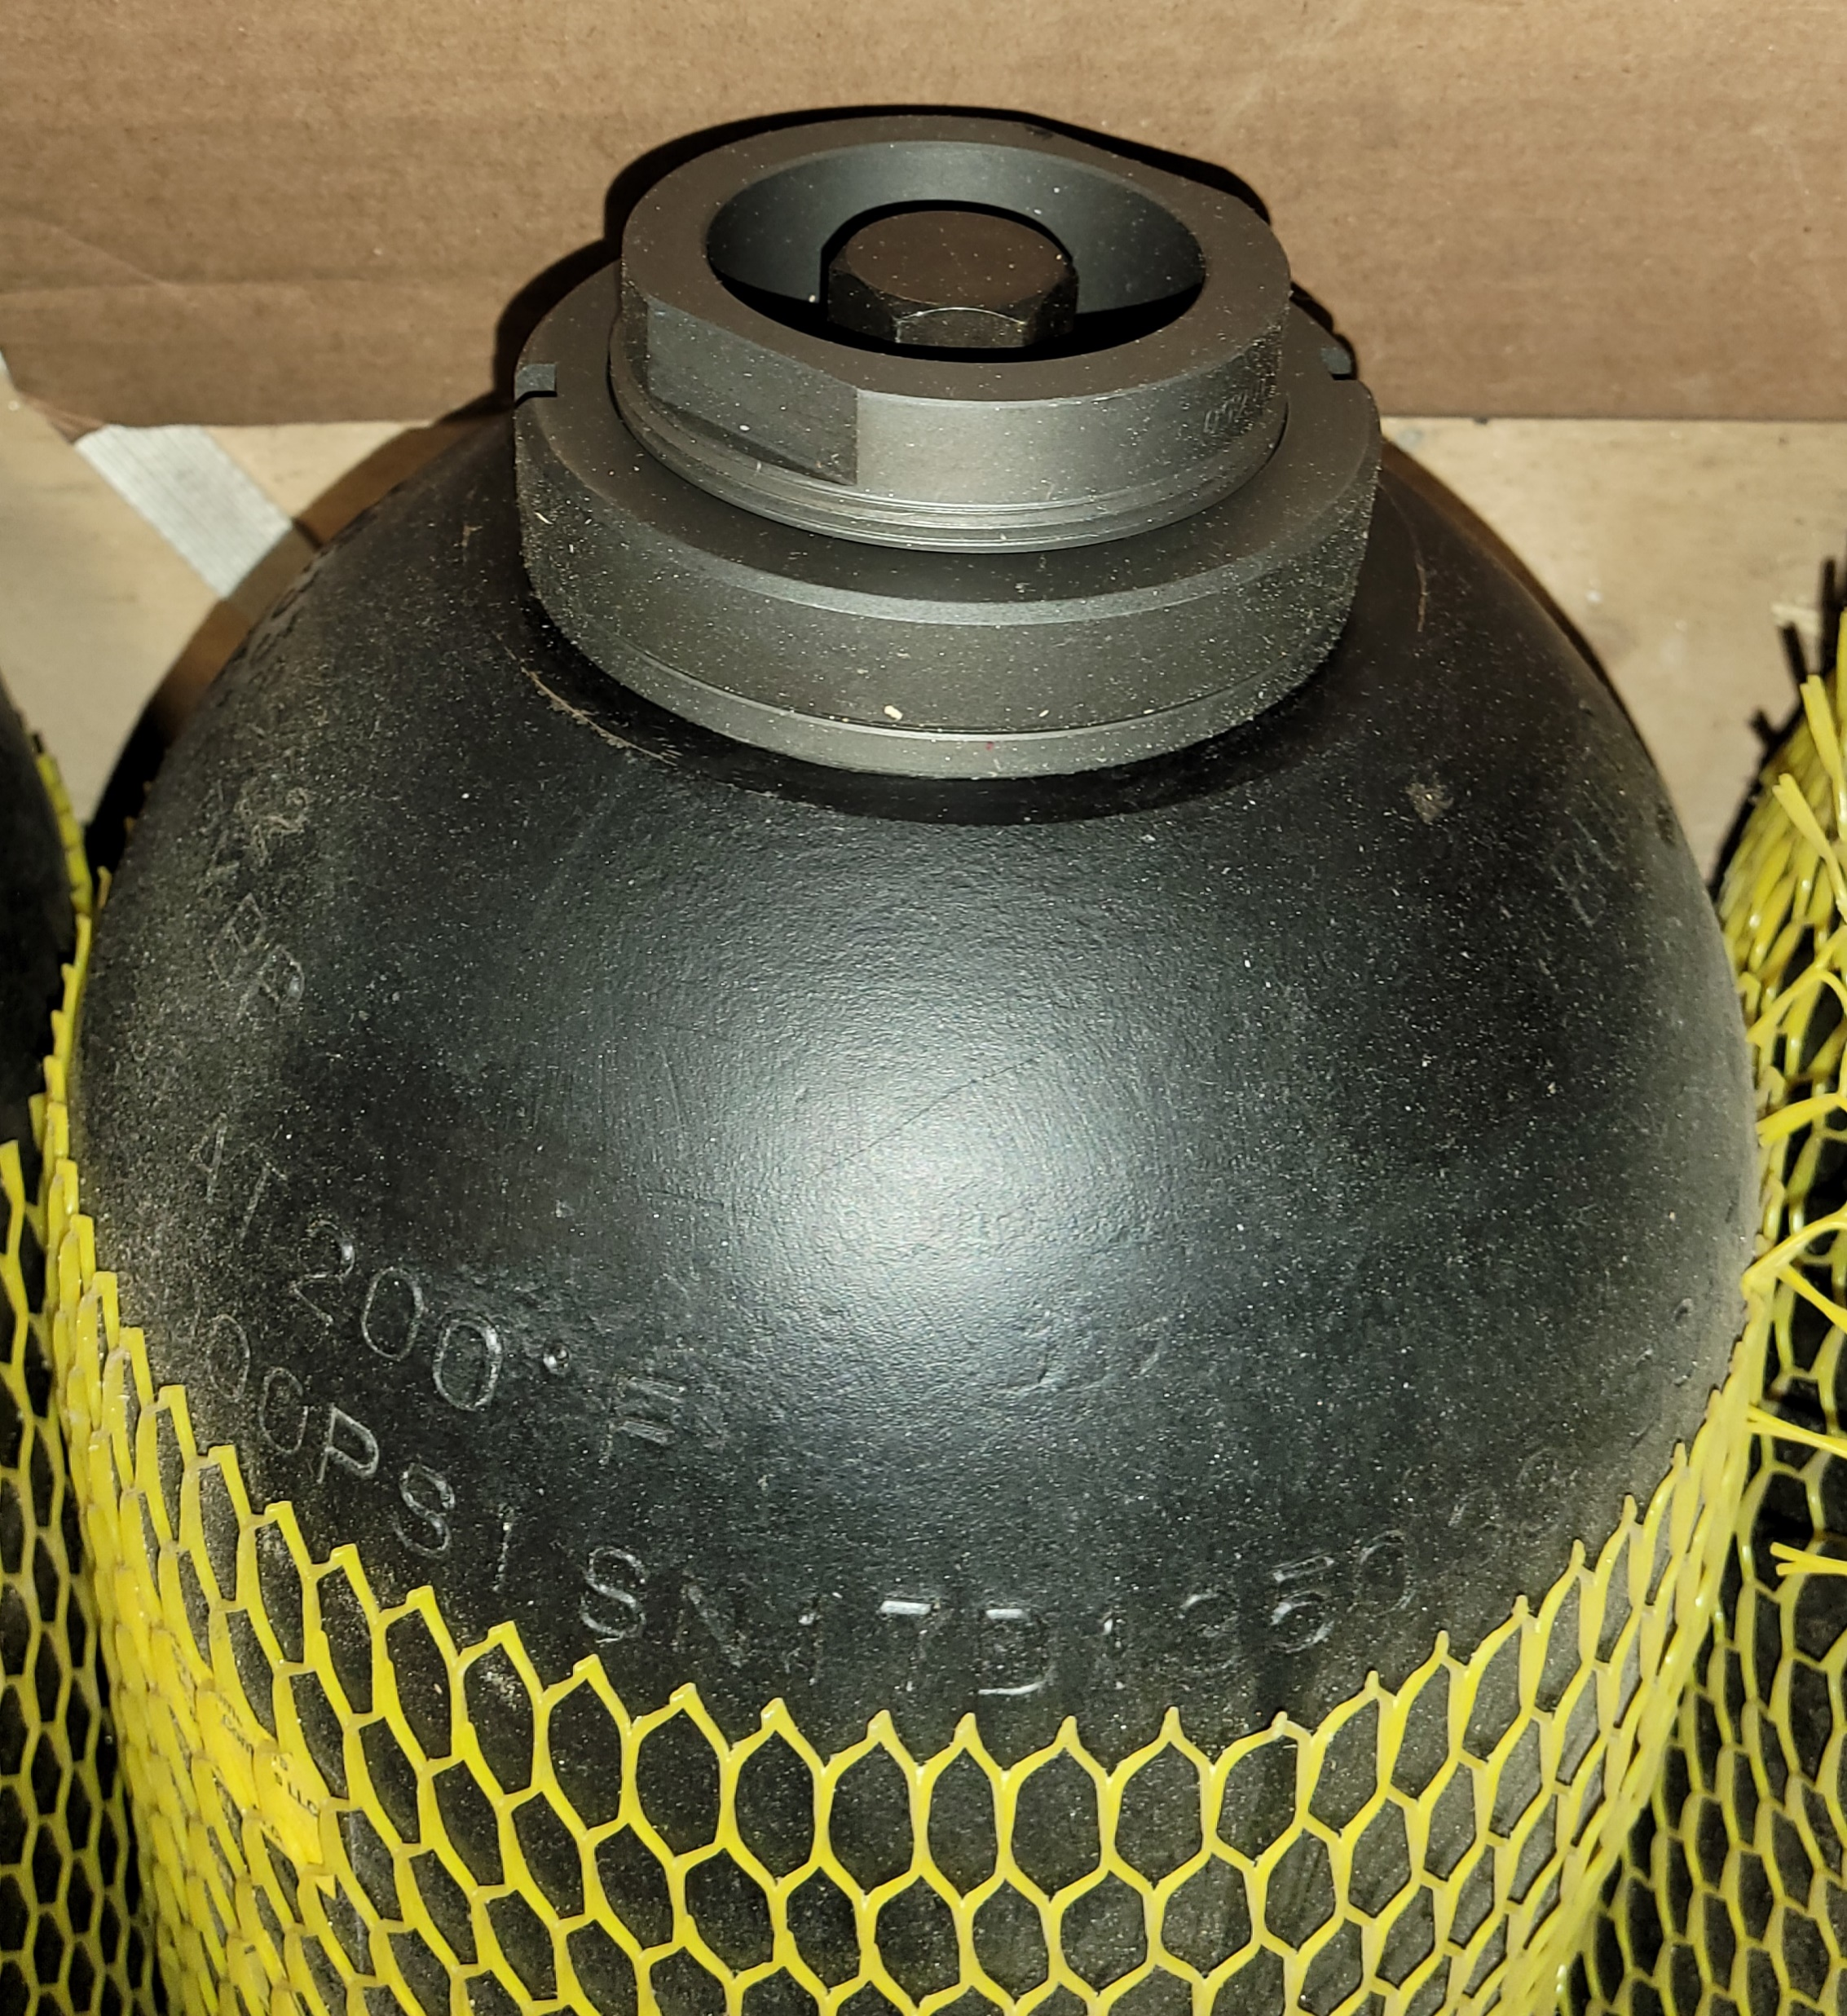
Bladder
Convenience Configurations
All pressure ranges are available in top & bottom repair, though not the smaller sizes.
Top repair allows the unit to be serviced while it is in place. A safety lock-out valve is used to isolate the energy from the system.
It is generally much more convenient to replace a bladder in 15 gallon unit while it is in place.
Bottom repair is the least expensive and most common
ACCUMULATORS, REPAIR KITS, and ACCESSORIES

Slide 11
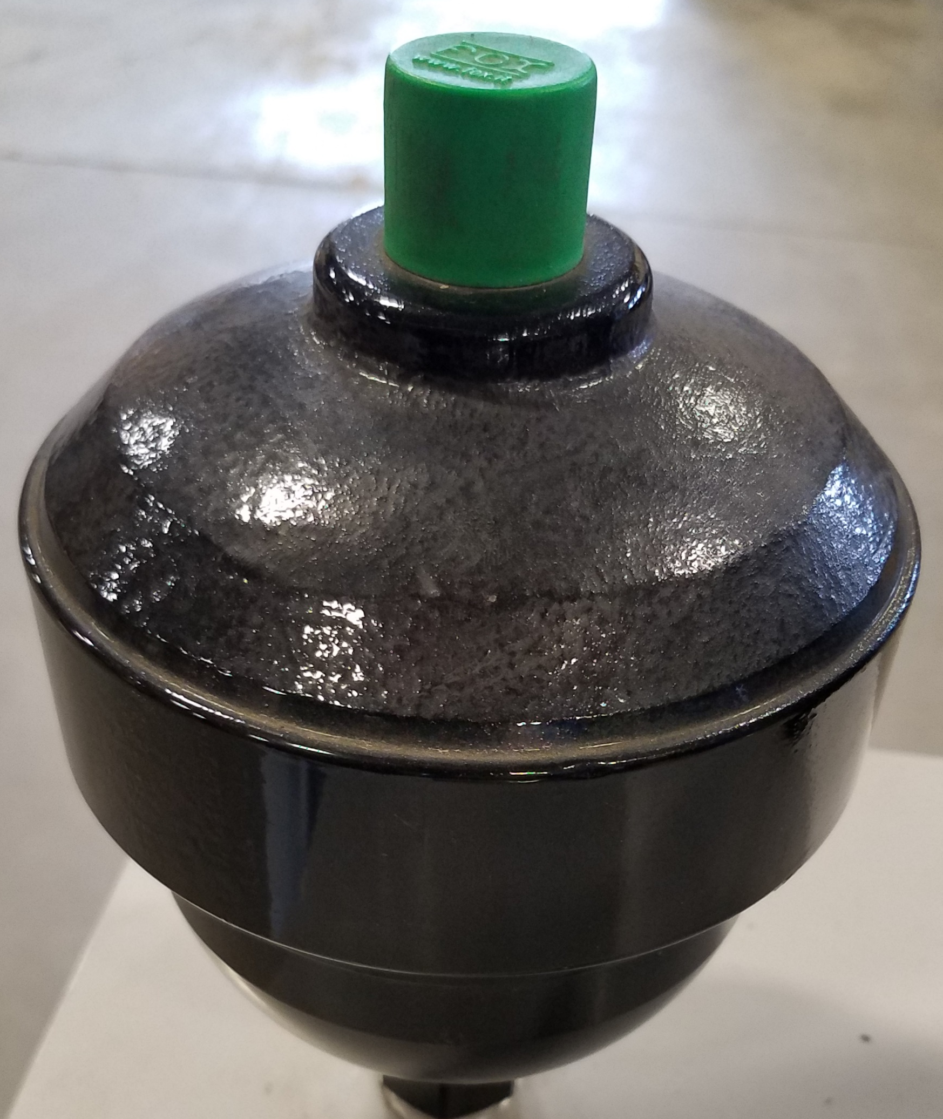
ACCUMULATORS, REPAIR KITS, and ACCESSORIES
Diaphragm
Generally small capacity; 1 gallon and less.
These can be both repairable and non-repairable.
Generally, readily available.
Great for mobile applications

Slide 12
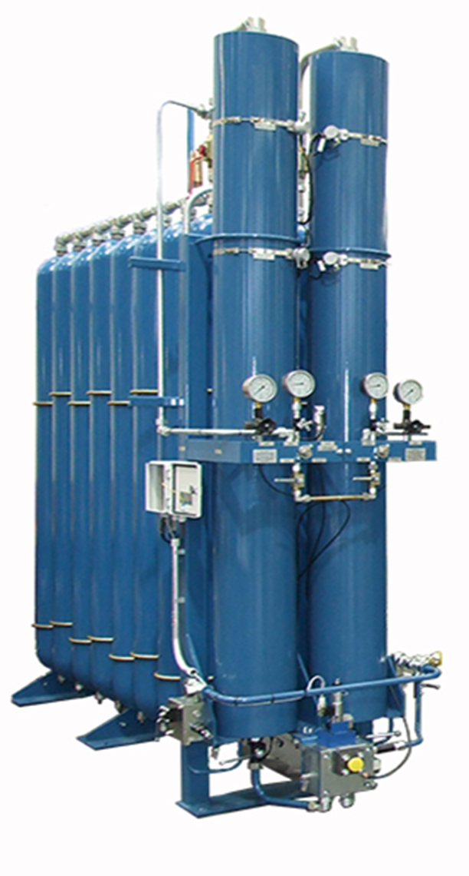
Piston
Can be small or as large as economically feasible.
Can be any volume - not specific sizes. Can be HUGE!
These are mostly repairable, though some of the smaller units are
not.
Are less tolerant of contaminants.
Can be mounted effectively in any position.
Often have remote gas bottles.
Can have long lead times to purchase.
ACCUMULATORS, REPAIR KITS, and ACCESSORIES

Slide 13
Mounting:
Piston & diaphragm accumulators can be mounted in any orientation, much more so than bladder accumulators.
Horizontally mounted bladder accumulators can suffer from premature bladder wear and need to have their volume de-rated, as oil can get trapped inside.
Pre-Charge:
Bladder accumulators should not be charged less than 40% of the maximum system pressure. Bladder deformation and failure can occur due to being extruded into the gas valve port.
Diaphragm accumulators can go as low as 20% of system pressure before premature failure is expected.
Piston accumulators can go to a very low pre-charge with no premature failure.
ACCUMULATORS, REPAIR KITS, and ACCESSORIES

Slide 14
What should our gas pre-charge be?
This is based on the max system pressure and will likely be different for each team.
Rule of thumb for starting out is 50% of system pressure
Too low and you may compromise the bladder and you will run out of fluid pressure so the fluid stays in the accumulator instead of doing work
Too high of pressure and you do not get the most efficient amount of fluid to do work. An extreme example would be that the fluid never enters the accumulator
ACCUMULATORS, REPAIR KITS, and ACCESSORIES

Slide 15
Response time:
Bladder and diaphragm accumulators respond the fastest, though piston accumulators can generally respond within 25 milliseconds.
Bladders and diaphragms are basically instantaneous, as there is no seal stiction or piston mass to accelerate.
They work best for absorbing spikes or feeding fast-acting servo valves.
Flow Rates:
Standard bladder accumulators should not exceed 220 gpm, as the poppet can be prematurely closed at higher flow rates.
Piston accumulators are not limited to flow rates, but to piston velocities due to seal damage. Generally, this is 10 ft/sec.
ACCUMULATORS, REPAIR KITS, and ACCESSORIES

Slide 16
Cost:
Diaphragm $
Bladder $$
Piston $$ to $$$$$$$
Generally, the diaphragm and bladder accumulators are the best value, strictly looking at volume per dollar.
Technology Integration:
Diaphragm and Bladder accumulators are relatively boring.
Gas side pressure monitoring using transducers or permanent gauging and a variety of shell and bladder materials is about as exciting as they get.
Piston accumulators can be fitted with the above, as well as piston monitoring systems. These can be LVDTs or Discrete Piston Position Sensors.
ACCUMULATORS, REPAIR KITS, and ACCESSORIES

Slide 17
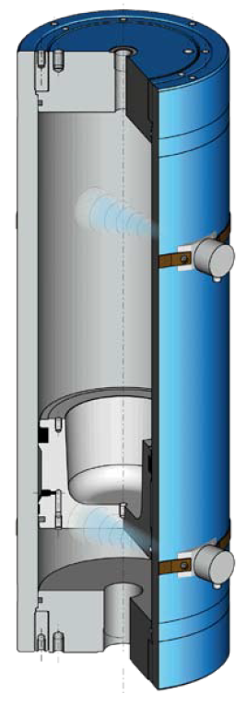
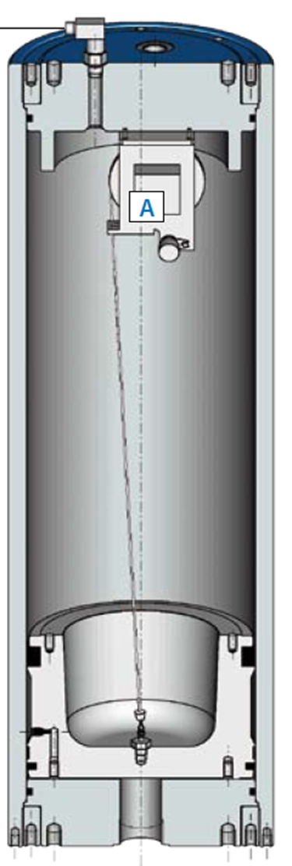
ACCUMULATORS, REPAIR KITS, and ACCESSORIES
Sensing technology is increasing everyday.
String pots
Ultrasonic
IR
LVDT Rods
Discrete Piston Position Sensors Continual Piston Position Monitoring

Slide 18
Fluid Compatibility:
Each type of accumulator can be manufactured to meet the compatibility requirements of almost any fluid.
Shells & tubes can be carbon, stainless steel, composites or coated.
Bladder and Diaphragm seals can be Buna-N, EPR, Viton, Butyl, or Hydrin.
Piston seals are similar, plus can be a wider variety of compounds or polymers.
ACCUMULATORS, REPAIR KITS, and ACCESSORIES

Slide 19
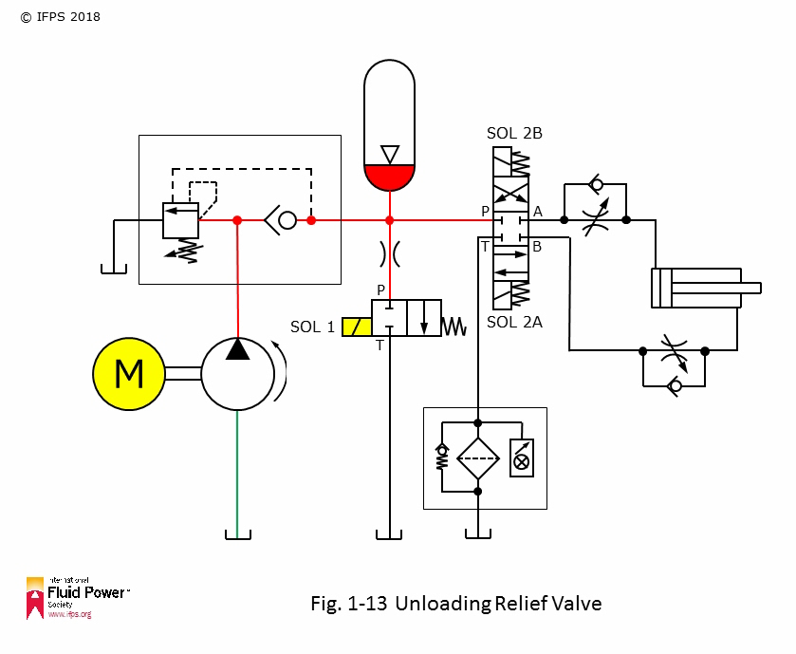
Accumulators:101
Boyle’s Gas Law
P1 x V1 = P2 x V2
At absolute pressure and constant temperature
P1 x V1 = P2 x V2
10G x 1,000PSI = P2 x V2
10,000 = P2 x 5G
P2 = 2,000 PSI

Slide 20
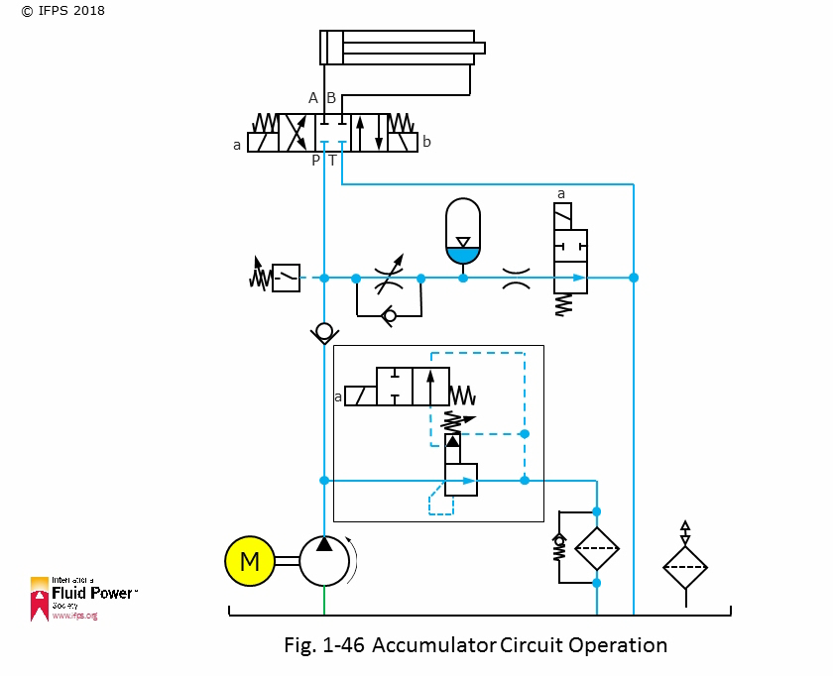

Slide 21
ACCUMULATORS, REPAIR KITS, and ACCESSORIES
Applications for Accumulators:
1. Energy storage for energy efficiency
2. Energy storage for safety/security
3. Surge suppression

Slide 22
ACCUMULATORS, REPAIR KITS, and ACCESSORIES
Applications for Accumulators:
Energy storage for energy efficiency
An accumulator can receive and store pressurized fluid during low-flow requirements of a process.
As an extreme, a 1 GPM pump can be used to fill a 2.5-gallon accumulator which can release 100 Hp worth of fluid for a fraction of a second. Hydraulic launch systems often use this principle.

Slide 23

Lift for Ford Motor Co. at Detroit Auto Show
ACCUMULATORS, REPAIR KITS, and ACCESSORIES

Slide 24
Lift for Ford Motor Co.
Machine cycle time determines the Hp input requirement
The challenge was to create a system using only 15 Hp, that could lift 12 people to 20 feet, rotate electrically for 1 minute, then return back to a 40” high stage.
We identified the high-flow, low-flow and no-flow segments of the cycle as well as the pressure requirements. We needed max flow & pressure to lift, low flow & pressure to lower, and no flow to load, rotate & unload.
We utilized 12, 5-gallon bladder accumulators in parallel. This provided 30 gpm @ 2500 psi, (45 Hp worth), so we achieved 60 Hp of work.
ACCUMULATORS, REPAIR KITS, and ACCESSORIES

Slide 25
ACCUMULATORS, REPAIR KITS, and ACCESSORIES
Applications for Accumulators:
Energy storage for energy efficiency of a Vehicle
Hydraulically charge the accumulator while pedaling downhill or standing still.
Use regenerative braking to charge the accumulator & store energy for starting

Slide 26
ACCUMULATORS, REPAIR KITS, and ACCESSORIES
Applications for Accumulators:
Energy storage for safety/security
Used on clamping circuits to make up for valve leakage (on working port).
Used to absorb volume from thermal expansion.
Used in case of a power outage as reserve energy for shutting down a machine.
Reserve energy for security on hydraulic vehicle barriers and blast doors.These often do not have an automatic safety bleed-down.

Slide 27
ACCUMULATORS, REPAIR KITS, and ACCESSORIES
Applications for Accumulators:
Surge Suppression
On pressure lines to smooth out the pulsation of the piston shots of piston pumps.
On return lines to eliminate decompression (water hammer).
On return lines to absorb higher-than-acceptable back pressure.
On actuator ports to absorb shock, like forklift and front loader mast cylinders and rock crushers. (See next slide)

Slide 28
ACCUMULATORS, REPAIR KITS, and ACCESSORIES
Applications for Accumulators:
Surge Suppression on pedal vehicles
If the accumulator is in parallel to the motor circuit, some fluid may go into the accumulator as well as through the motor
The most force in pedaling is when the pedals are at 90 degrees to the rider. The accumulator could be providing power during the lessor-force quadrants.

Slide 29
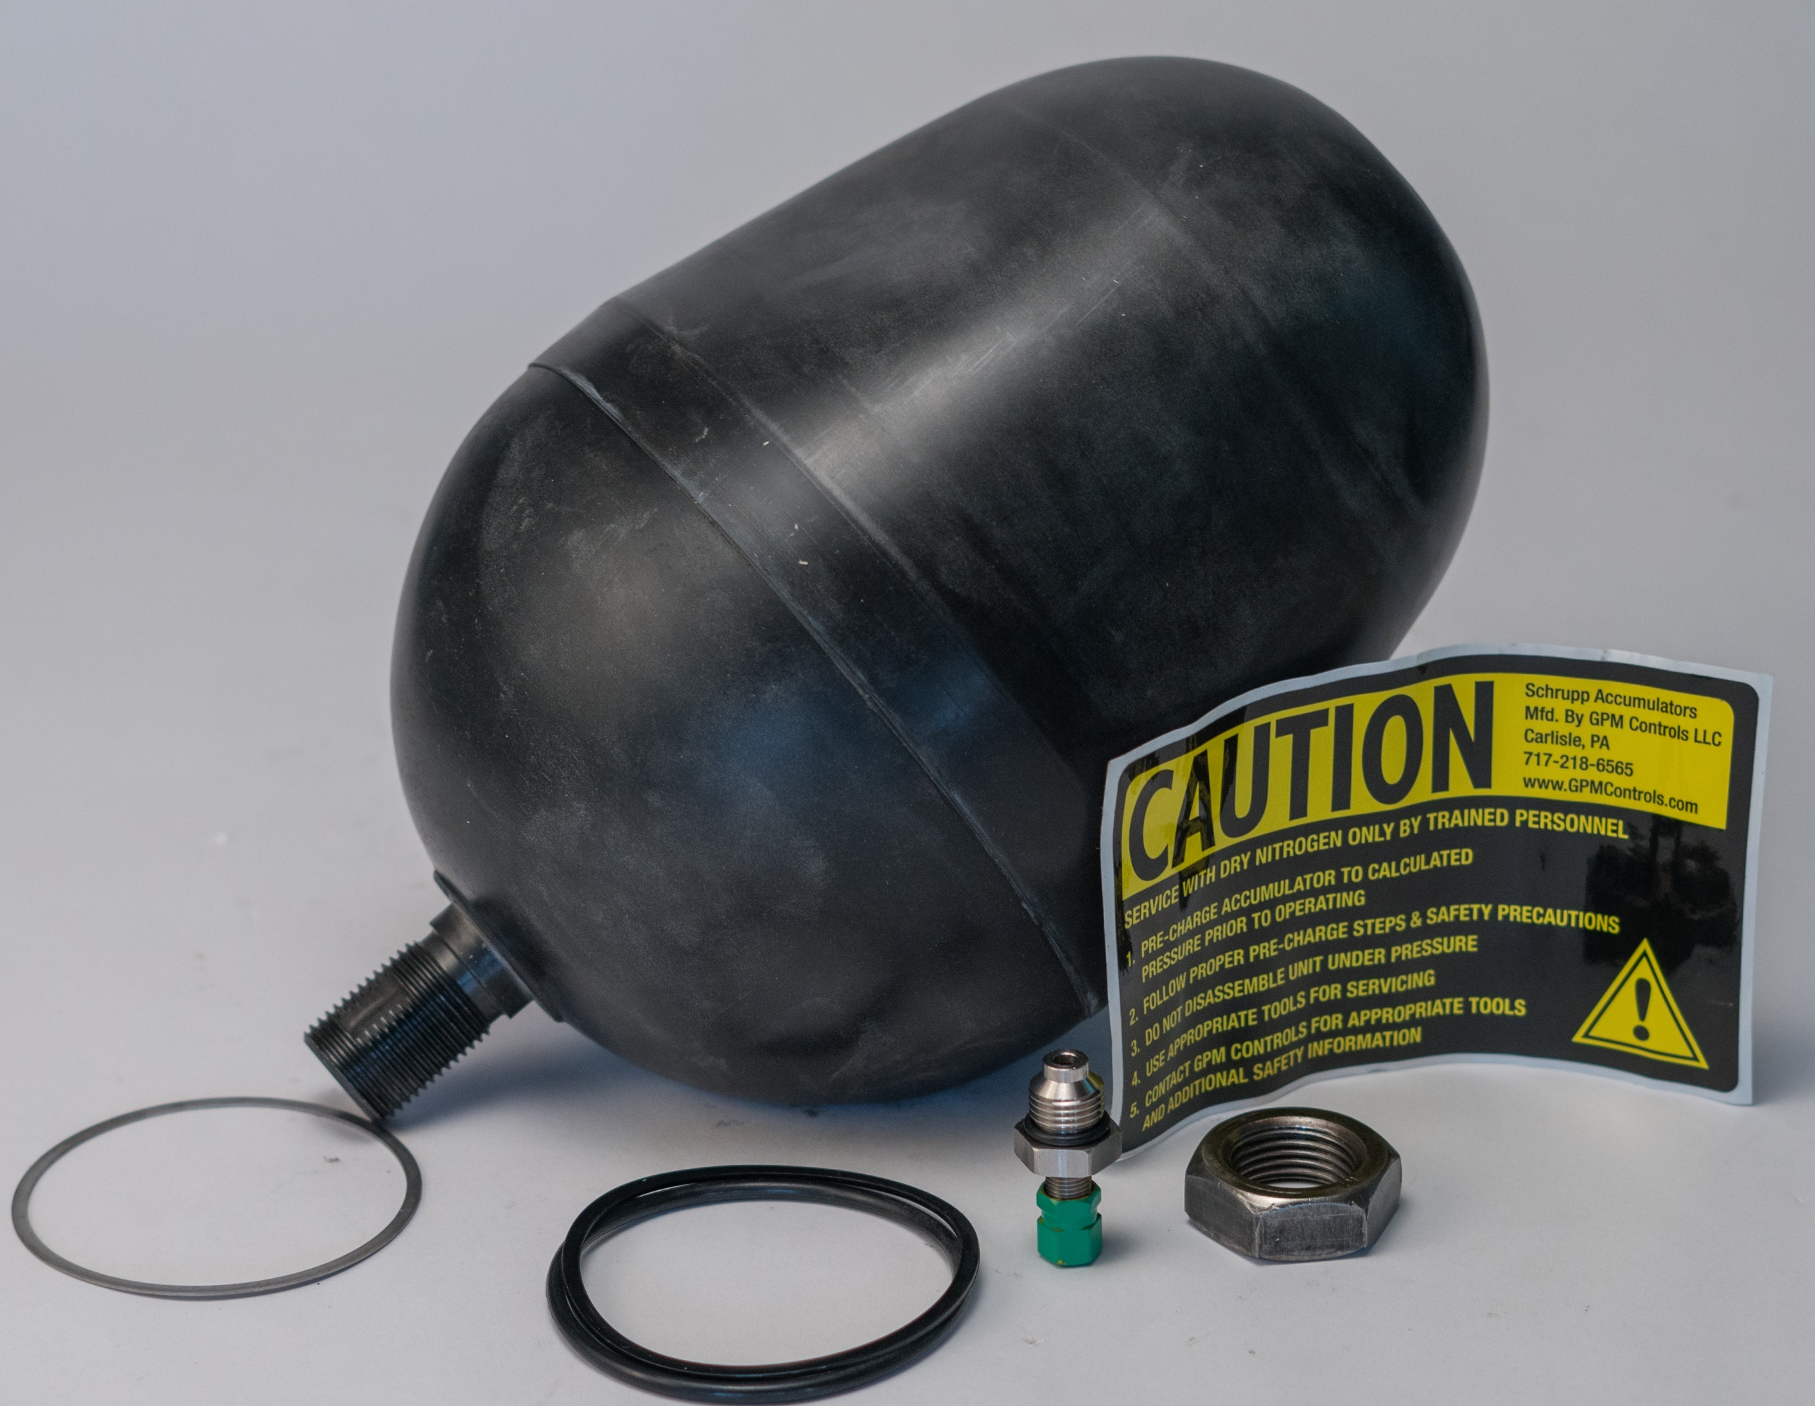
ACCUMULATORS, REPAIR KITS, and ACCESSORIES
Repair Kits
Most are interchangeable.
Call out:
Size, Material, Pressure, and Top/Bottom Repair

Slide 30
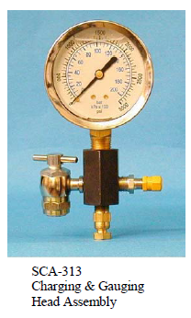
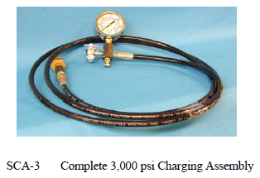
Tools

Slide 31
ACCUMULATORS, REPAIR KITS, and ACCESSORIES
Safety Tips to Know, Practice & Live By
An accumulator may still have a dangerously high gas pressure even though the hydraulic gauge reads zero. Before servicing an accumulator, make sure that all gas pressure has been released.
Only use an inert gas, such as Nitrogen. Compressed air mixed with oil is lethal at high pressures.
When servicing a machine, look for accumulators and make sure they are locked out and/or completely drained of hydraulic pressure.
Do not transport fully charged accumulators unless they are approved for transport.
Secure accumulators properly with specifically designed clamping systems.
When the hydraulic fluid is drained from the accumulator, the pre-charge gas pressure remains in the accumulator and is energy that must be isolated or removed before any service is done. Be aware that some cylinders have accumulators built into them, and they need to be treated with caution.

Slide 32
ACCUMULATORS, REPAIR KITS, and ACCESSORIES
So Much More:
This is intended to be an introduction to accumulators.
There are many do’s & don’ts to sizing, selecting, installing and maintaining accumulators.
Accumulator safety, sizing & selection are topics that need to be understood before recommending and purchasing accumulators. Separate training is available for this.

Slide 33
ACCUMULATORS, REPAIR KITS, and ACCESSORIES
Thank You for this Opportunity

