Slide 1


Kick-Off Webinar
2018 – 2019

Slide 2
Sizing of Components and Conductors
Objectives:
Calculate the pull of the vehicle
Calculate the torque of the drive wheel
Determine your system pressure (PSI)
Size the drive motor for cubic inches per revolution (CIR)
Calculate wheel RPM
Calculate GPM (gallons per minute)
Calculate HP (Horsepower)
Size the hydraulic lines
Size the pump

Slide 3
System Pressure
System pressure based on working pressure of weakest component/conductor in system
Working pressure- pressure manufacturers are comfortable having their components run at (for safety and efficiency reasons)
Similarities:
  Pressure (P); (PSI or MPA) = Voltage (E)
  Flow (Q); (GPM or LPM) = Amperes (I)
  E = IR; P = Flow x Constant
Notes:
Determine System Pressure:
Pressure of your system is basic on the working pressure of the weakest component or conductor in your system. Working pressure is a pressure that the manufactures are comfortable having their components run continuously at without a safety problem. The higher the pressure, the lower the flow requirements are. Double the pressure cut the flow in half. Pressure is the same as voltage, flow is the same as amperes. The formulas work the same in hydraulic or pneumatics as they do with electricity only using a different constant.

Slide 4
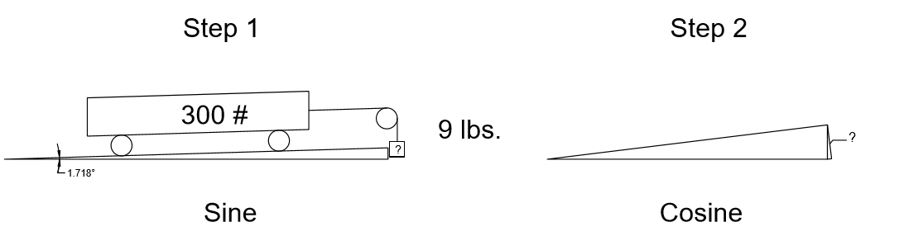
Push/Pull of Vehicle
Two Considerations:
Maximum incline that you will be going on
Rolling resistance
Consider the following system, with a 3% grade
Notes:
Calculations for push or pull of your vehicle:
There are two questions that we need to answer
What is your maximum incline that you will be going on?
What is your rolling resistance?
Finding the variables is generally our biggest concern because garbage in means garbage out.

Slide 5
Start with Incline
Assume 3% grade
  tan⁻¹(.03)=1.718°
Find rolling resistance for given materials using available charts
  e.g. .002 for concrete, -.04 for sand
Notes:
Calculations for push or pull of your vehicle:
Starting with the incline. Let’s use a 3% grade and let’s convert that to degrees in incline. If we do the Tan¯¹ of .03 (3%)= 1.718°
Using various charts that are available on-line we will fine that the rolling resistance for a bicycle is between .002 on concrete - .04 on sand.

Slide 6
Pull to Climb Hill
Assume load of 300 lbs.
- sin(1.718) x 300 lbs. = 9 lbs. of pull
2. Assume rolling resistance of .04
- cos(1.718) x 300 lbs. x .04 = 12 lbs. of pull*
Uphill: total pull = 9 + 12 = 21 lbs. of pull
Downhill: total pull = 12 – 9 = 3 lbs. of pull
*Note: pull would be different on concrete/different material
Notes:
Use the following 3 steps to find the pull to climb the hill:
1. Take the sine of the angle (1.718) x GVW (bicycle and rider)
Example sine of 1.718 x 300 lbs. = 9 lbs. of pull
2. Take the cosine of the angle x the load x rolling resistance
Example cosine of 1.718 x 300 x .04 = 12 lbs. of pull. (Note if on concrete that pull would only be .6 lbs. The steeper the hill the higher step 1 will be, but the lower step 2 will be.)
3. For going uphill, add answer 1 & 2. For going downhill subtract the two answers.
9 lbs. + 12 lbs. = 21 lbs. of pull for our worst case.

Slide 7
Torque
Torque (lb. in) = Radius (in) x Pull (lb.)
Example: D = 28”, Radius is 14”
Pull = 21 lbs.
T = 14 x 21 = 294 lb. in.
Notes:
Calculation for torque:
Torque (lb. In.) = Radius (in inches) x Pull
Radius of a 28” bicycle tire is 14”
T = 14 x 21 = 294 lb. in.

Slide 8
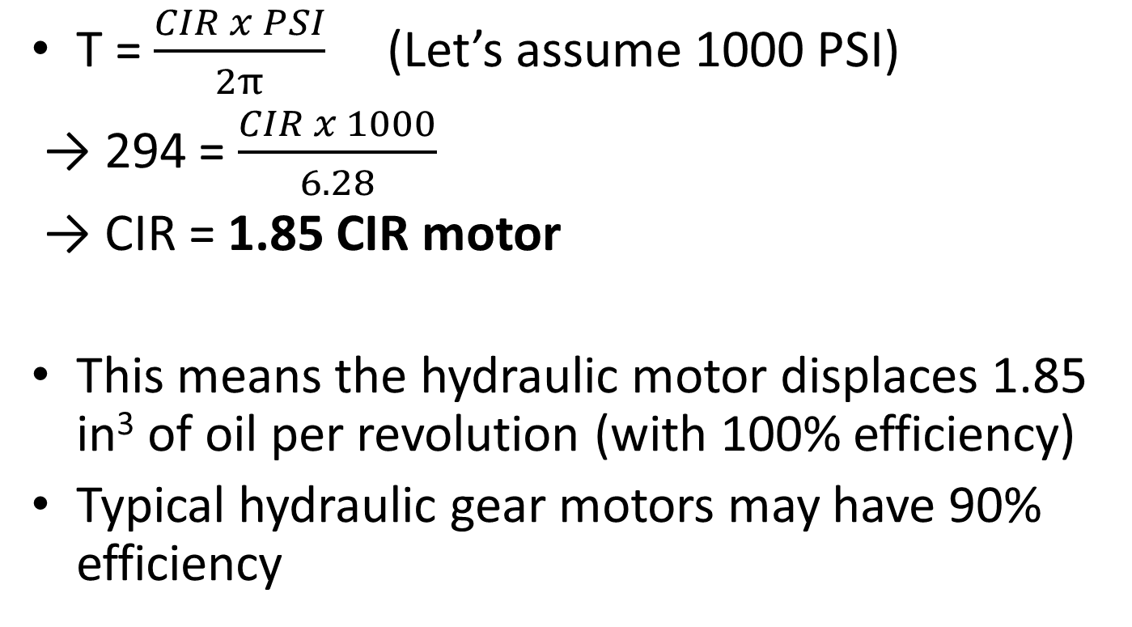
Sizing of Drive Motor
T = $\frac{CIR x PSI}{2π}$ (Let’s assume 1000 PSI)
→ 294 = $\frac{CIR x 1000}{6.28}$
→ CIR = 1.85 CIR motor
This means the hydraulic motor displaces 1.85 in³ of oil per revolution (with 100% efficiency)
Typical hydraulic gear motors may have 90% efficiency
Notes:
Sizing of drive motor/motors:
For our calculations, I will use what is basically considered to be low pressure, 1000 PSI.
T (lb. in.) = CIR x PSI
2π
294 = CIR x 1000 / 6.28 CIR = 294 x 6.28 / 1000 CIR =1.85 CIR motor
This means that the hydraulic motor is displace 1.85 cubic inches of oil for each revolution that it turns. These calculations are bases on 100% efficiency. A very typical hydraulic motor will have around 90% mechanical efficiency. This would mean that you would either up side the motor (1.85 / .9) to 2.05 CIR or your pressure would increase to 1111 PSI. Let’s work with the 2.05 CIR motor. 2.05 x 16.38 = 33.58 cc

Slide 9
Calculating inefficiency
Let’s oversize the motor to compensate for the volumetric efficiency. (Internal slippage)
1.85 / .90 = 2.05 CIR

Slide 10
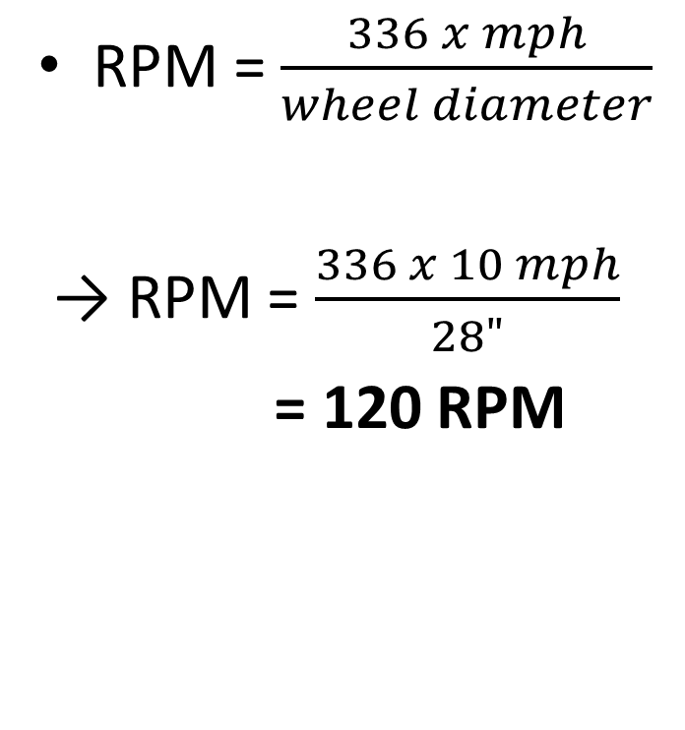
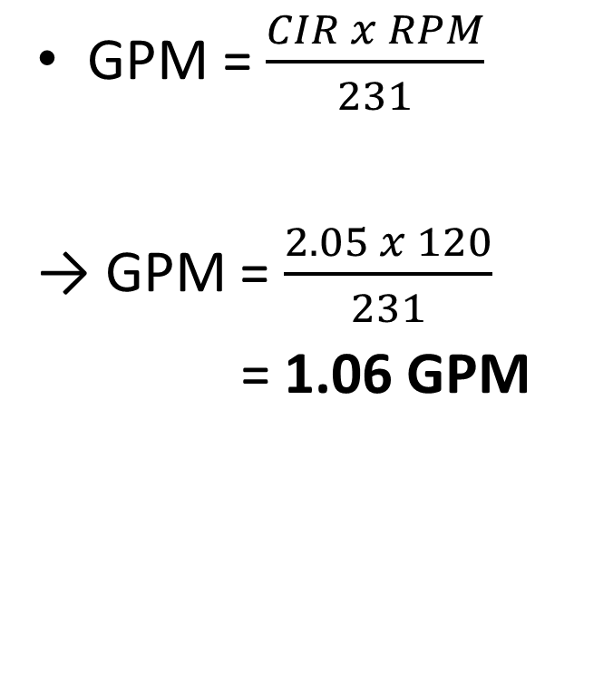
Wheel RPM and GPM
RPM = $\frac{336 x mph}{wheel diameter}$
→ RPM = $\frac{336 x 10 mph}{28"}$
= 120 RPM
GPM = $\frac{CIR x RPM}{231}$
→ GPM = $\frac{2.05 x 120}{231}$
= 1.06 GPM
Notes:
Calculating the wheel RPM:
Here is a formula that I came up with many years ago for calculation wheel RPM. RPM = (336 x mph)/ Wheel Dia.
336 x 10 mph / 28” wheel = 120 RPM
Calculating GPM:
GPM = CIR x RPM Note: there is 231 cubic inch to a gallon
231
GPM = 2.05 x 120 / 231 = 1.06 GPM
Many motors run at 95% volumetric efficiency or better. This means take our 1.065 GPM and / .95 and that equals 1.12 GPM.

Slide 11
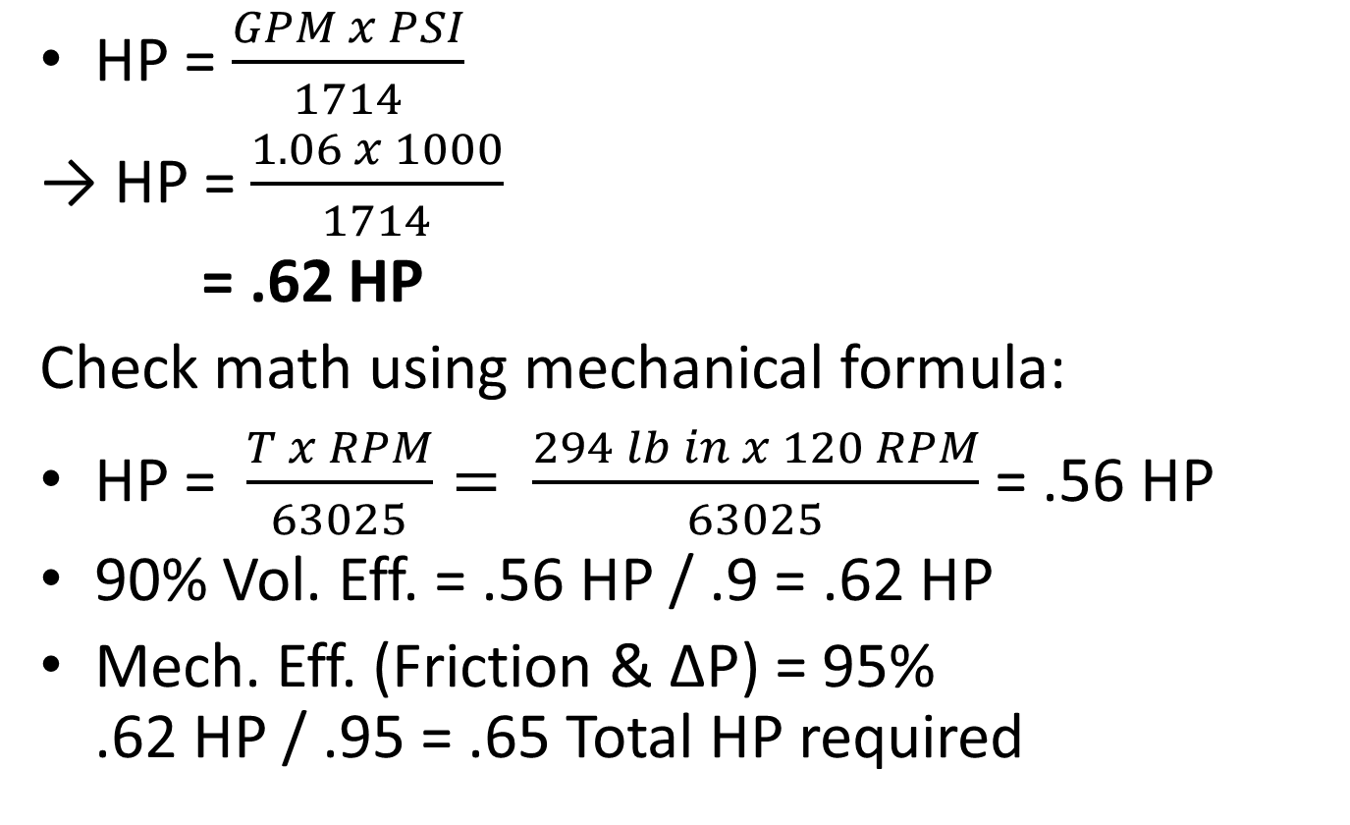
HP
HP = $\frac{GPM x PSI}{1714}$
→ HP = $\frac{1.06 x 1000}{1714}$
= .62 HP
Check math using mechanical formula:
HP = $\frac{T x RPM}{63025}= \frac{294 lb in x 120 RPM}{63025}$ = .56 HP
90% Vol. Eff. = .56 HP / .9 = .62 HP
Mech. Eff. (Friction & ΔP) = 95% .62 HP / .95 = .65 Total HP required
Notes:
Calculation of HP:
HP = GPM x PSI HP = 1.12 x 1000 / 1714 HP = .65 HP
1714
Check our math by using the mechanical HP formula.
HP = T x RPM 294 lb. in x 120 RPM / 63025 = .56 HP
63025
we can take .56 / .9 /.95 = .65 HP
The volumetric efficiency is made up with additional pump flow
90% ME x 95% VE = 85.5% OV (overall efficiency)
With a 100% drive system, it will still take .56 HP to overcome the hill and rolling resistance at 10 MPH.

Slide 12
Line Sizing
Sizing is IMPORTANT
  Undersized lines cause excess pressure drop and heat
Different sizing standards in industry
  16 ft./sec. in pressure line for ISO, 20 ft./sec. for ANSI
Inlet is also critical
  Have no restrictions within last 10 diameter at pump inlet
Notes:
Line sizing:
Plumbing and line sizing is very important when designing a hydraulic or pneumatic system. Undersize lines and poor plumbing cause excess pressure drop and heat just as an extension cord causes voltage drop. There are different standards in the industry for line sizing. ISO uses 16 feet per second in a pressure line, 8’ / second in a return line and not more than 4’ / second to an inlet to a pump. ANSI uses 20’ / second for pressure lines and not more than 5’ / second inlet velocity. This is the one I prefer to use if you truly calculate all velocities. SAE goes as high as 25’ / second in hydrostatic systems. The inlet is very critical. Don’t use any elbows or restriction within the last 10 diameter at the pump inlet. This means is your inlet hose is 1”, don’t use any elbow or restrictions any closer than 10” from the pump. A 3/8” hose needs 3.75” or laminar flow going into the pump. I use a bulkhead fitting going into the reservoir and then a piece of tubing that is flare with the standard 37° flare on the end for the pickup tube. A shut-off ball valve can be used to facilitate pump repair, but keep the valve next to the tank and not the pump. Likewise if you have to use an inlet strainer.

Slide 13
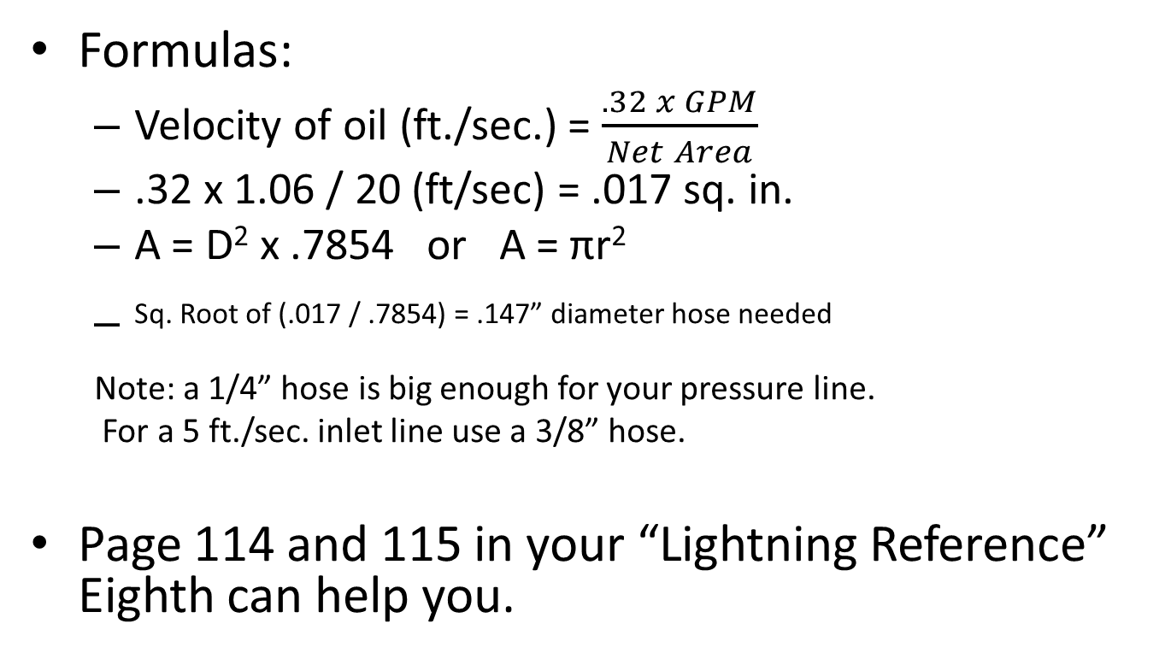
Line Spacing, cont.
Formulas:
  Velocity of oil (ft./sec.) = $\frac{.32 x GPM}{Net Area}$
  .32 x 1.06 / 20 (ft/sec) = .017 sq. in.
  A = D² x .7854 or A = πr²
  Sq. Root of (.017 / .7854) = .147” diameter hose needed
Note: a 1/4” hose is big enough for your pressure line.
For a 5 ft./sec. inlet line use a 3/8” hose.
Page 114 and 115 in your “Lightning Reference” Eighth can help you.
Notes:
Line spacing, cont:
I recommend that each team have a copy of the “Lightning Reference” when designing their systems. There is a lot of helpful information all put into one book. I know that www/IFPS.org does sell them. One of the things that you will notice when looking at their charts is that the pressure drop making a sharp 90-degree turn is three (3) greater than going straight. Gradual bends are much better.
Using a formula:
Velocity of oil (Ft. / Sec.) = .32 x GPM
Net Area
Hydraulic hoses are measured by the ID (Inside diameter) and hydraulic tubes are measure by the OD (Outside diameter). You have to subtract the wall thickness when calculating area. -4 hose means 4/16” hose, -8 equals 8/16” of 1/2”.
Working the formula .32 x 1.065 / 20 = Area A = .017 in²
Find Diameter
A = D² x .7854 or A = πr²
.017 / .7854 = D² of .0217 D = square root of .0217 = .147 inch inside diameter. A ¼” hose is big enough for your pressure line. Doing the same math for 5’ per second inlet line would require a 3/8” hose.

Slide 14
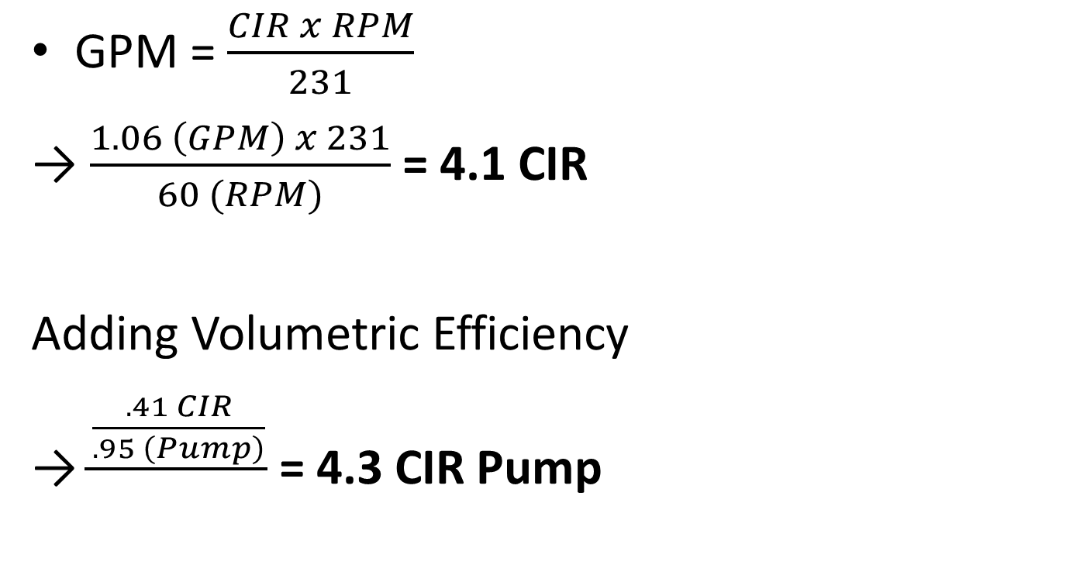
Size of the Pump
GPM = $\frac{CIR x RPM}{231}$
→ $\frac{1.06 \left(GPM\right) x 231}{60 (RPM)}$ = 4.1 CIR
Adding Volumetric Efficiency
→ $\frac{\frac{.41 CIR}{.95 \left(Pump\right)}}{}$ = 4.3 CIR Pump
Notes:
Size of the pump:
GPM = CIR x RPM / 231
Substituting: 1.065 (GPM) x 231 / 60 (RPM of pedals) = 4.1 CIR
Adding volumetric efficiency
.41 CIR / .95 (pump) / .95 (motor) = 4.54 CIR Pump
Note: actual pressure will change both the VE and ME in a system. The lower the pressure the higher the VE and the lower the ME. Higher flow rates can also lower the ME efficiency.
In my personal design, I calculate everything on 100% efficiency until I all done and then divide by my overall system efficiency.

Slide 15
Wind Resistance
A formula for wind resistance is:
Frontal area (Sq. Ft.) x MPH³ / 150,000
Examples: One square foot at 60 MPH =
1 x 60³ / 150,000 = 1.44 HP
One square foot at 30 MPH =
1 x 30³ / 150,000 = .18 HP
1.44 / .18 = 8 times the HP when the speed is doubled. That is four times the torque and twice the flow. 2² x 2¹ = 2³ or 8 times the power

Slide 16
Wind Resistance
When using the above formula add the speed of your bicycle and the wind that you are bucking as the MPH variable.
Side note: This formula is also effective for the speed of a fan. Doubling the RPM will require four times the torque and two times the speed or flow when using hydraulics.

Slide 17
Size of the Pump, cont.
Overall Efficiency = Volumetric Eff. X Mechanical Eff.
  Usually calculate everything with 100% efficiency, then divide by overall system efficiency
Math Check: Wheel RPM = 120, Pedal RPM = 60
  2:1 step up ratio, theoretical pump CIR should be twice the motor CIR
  Can proportionally size up or down the pump and motor to purchase an actual displacement made by a manufacturer
Notes:
Size of the pump, cont:
Note: OE (Overall Eff.) = VE x ME
Math check: Wheel RPM = 120
Pedal RPM = 60
Note a 2 : 1 step up ratio. Our theatrical pump CIR is twice the motor CIR.
You can proportionally up or down size the pump and motor to purchase an actual displacement that is actually made by a manufacture and the pressure will adjust accordingly.

Slide 18
Hydraulic versa Electric Hybrids
The big advantage is that hydraulic hybrid is far more efficient than an electric hybrid at capturing braking energy and accelerating and that it eliminates the need for a costly lithium-ion batteries.
Example 1: During braking the motor/generator becomes very inefficient at reduced speeds. A Toyota Prius recovers only 50 watts of energy. 746 watts is one HP. Most of the recovery is at low speeds with the engine running.

Slide 19
Hydraulic versa Electric Hybrids
Example 2: During acceleration, the electric hybrid can use full amp drain on the battery even though the wheels are just starting to turn. The hydraulic vehicle will only drain the accumulator as fast as the wheels are turning. If you stand on the brake and apply the accumulator, you will not use any energy or discharge the accumulator.

Slide 20
Hydraulic versa Electric Hybrids
Example 3: If an accumulator goes bad, it can be repaired for less than a couple hundred dollars and recharged with nitrogen.
If the electric battery goes bad and needs to be replace, the cost is more than an engine replacement. A Chevy Volt’s battery has a cost of over $20,000.
Hydraulics is much “greener”. If an accumulator seals or diaphragm goes bad, you will only loose nitrogen and doesn’t pollute anything. Purdue University has proven that a Hummer is actually greener than a Toyota Prius. Their batteries are very hard on our environment.

Slide 21

Questions?

