Slide 1


In-School Fluid Power Action Challenge
Workshop Day – Waterfall Drop Zone Challenge
Host / Organizer
Date
Notes:
Host / Organizer – feel free to edit this template to make it your own.

Slide 2



Agenda
Welcome to Workshop Day!
Teams Please…
Find Your Team’s Table
Watch and Listen for Directions
Do Not Open Any Boxes…We Will Do This Together
Notes:
KEEP THIS SLIDE UP AS TEAMS ARRIVE, CHECK-IN AND GET READY FOR WORKSHOP DAY

Slide 3

Fluid Power Action Challenge
NFPA’s Fluid Power Action Challenge is a STEM- based competition that challenges middle and high school students to solve an engineering problem using fluid power (hydraulics & pneumatics).
Benefit: students gain hands-on learning.
Student Opportunity: work on key skills like problem solving, communication, teamwork / collaboration, leadership, organization, project management, and time-management.

Slide 4


About the NFPA
National Fluid Power Association (NFPA) is a trade association of member companies focused on the Fluid Power Industry.
NFPA Education and Technology Foundation is a charitable organization affiliated with the NFPA that is dedicated to meeting the fluid power industry’s workforce development needs.
  NFPA owns and oversees the NFPA Fluid Power Action Challenge program.

Slide 5
Section Index
Safety considerations
Construction tips: using wood glue, using the miter box and hand saw to cut wood, using the hand drill to drill a hole in a syringe
Making a 4-inch Cube
Lifter
Rotating Platform
Documents needed – a checklist to refer to during presentation
Maximise event points:
  Strong & Stable Structure
  Placement of Fluid Power systems
  Iso-Ortho views illustrated
  Team Portfolio & AI Use, Portfolio Template, and Portfolio Checklist
  Challenge Scenario, Challenge Rules, Challenge Rubric, and Challenge Discussion
Team-work and work habits
The Challenge and its process
Using the piston-syringe clips
Base block and 4” Squares
Safety Review
Using sample resources
Sketching and organizing your time
Notes:
This is today’s agenda….let’s get started

Slide 6
Student Pre-Survey
Please complete the pre-survey to the best of your ability.
Your name is not required.

Slide 7
Behave Safely!
Safety is everyone’s responsibility!
Always wear safety glasses - even when not cutting, drilling, filing, or sanding
No Running, No Throwing, No Misusing the Tools, etc.
When sawing, drilling, filing or sanding…
  Ensure a miter box securely clamped down with the C-Clamp
  Ensure each workpiece is secure & stable
  Ensure your hands an fingers are out of harms way
  Wipe sawdust, don’t blow
The tip of the low-temp glue gun is HOT. Do not touch it.
Questions?
Notes:
The Hot Glue Guns may be used on Challenge Day…but not on Workshop Day or during the time students return to the classroom to research, design, and build the working prototype.
Glue gun sticks will be packed in the Challenge Day kit boxes

Slide 8
Construction Tips
Have a plan
Measure twice, cut once
Accuracy is important
Wood Glue
  Less is more!
  Excessive glue takes longer to ‘set-up’ & does NOT result in a stronger joint
  Use stick to spread out glue on contact surfaces
  Use gussets and structural members for strength
  Consider Center of Gravity of the device you make
  Know and understand how the piston-syringes are mounted

Slide 9
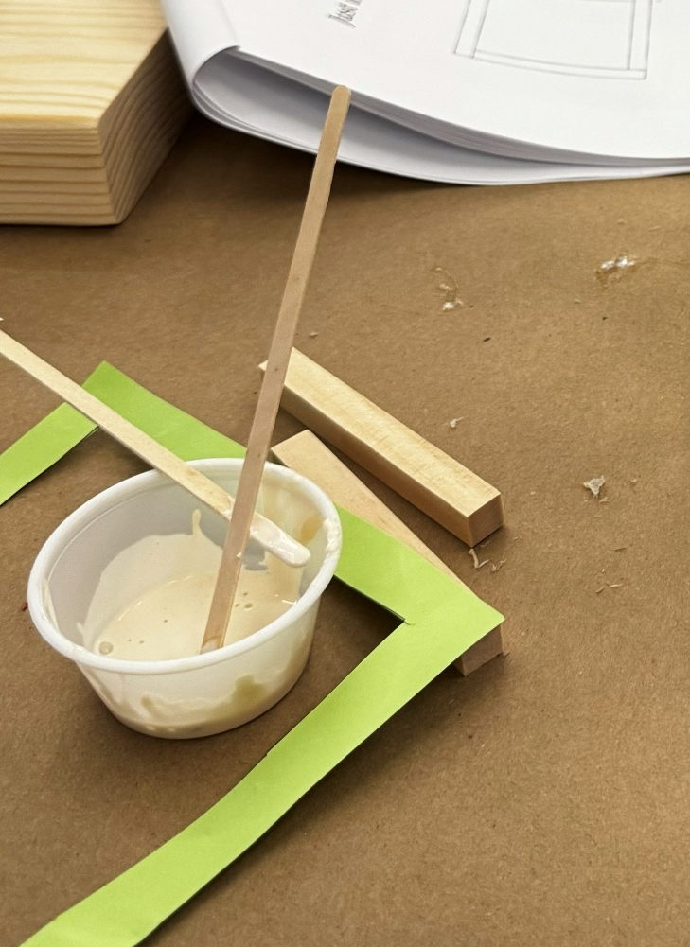
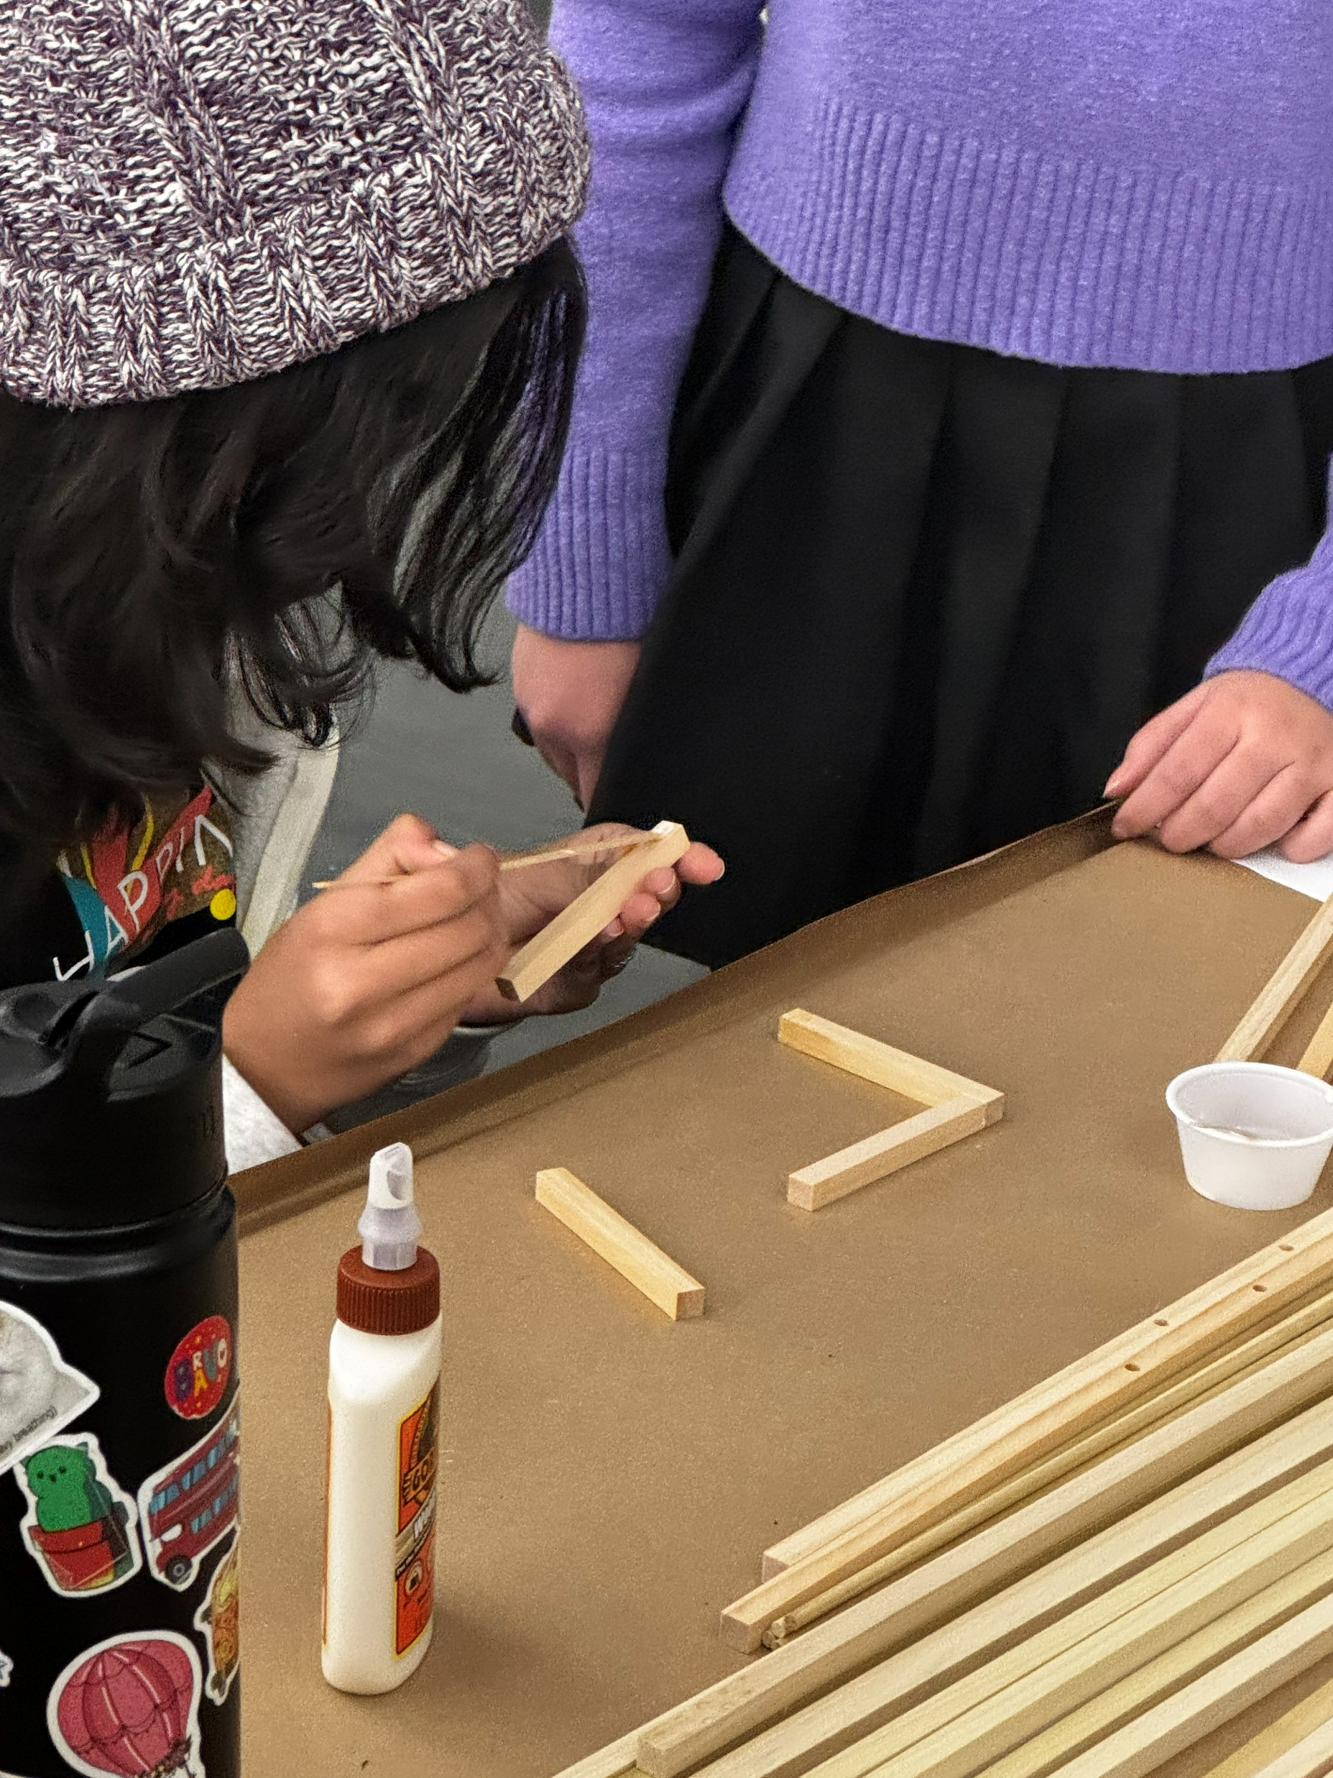
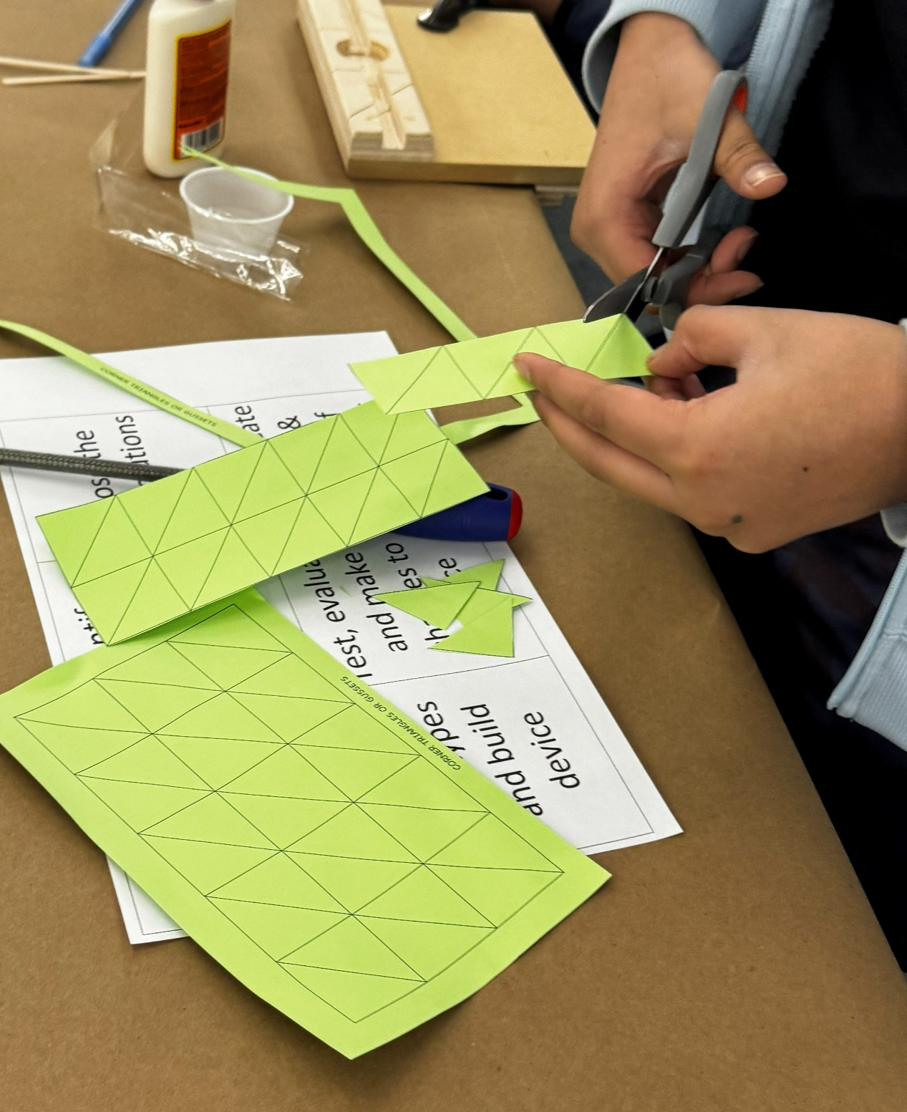
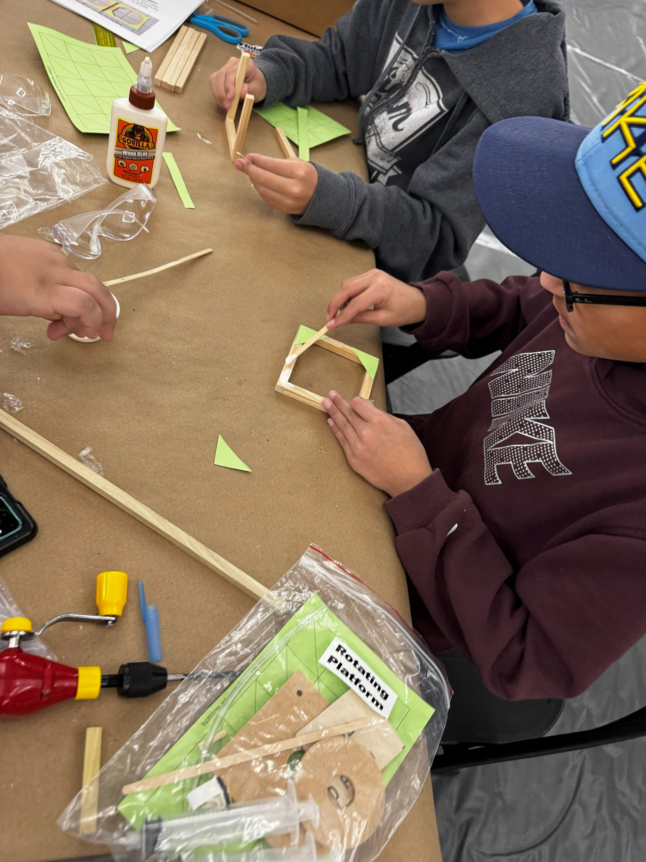
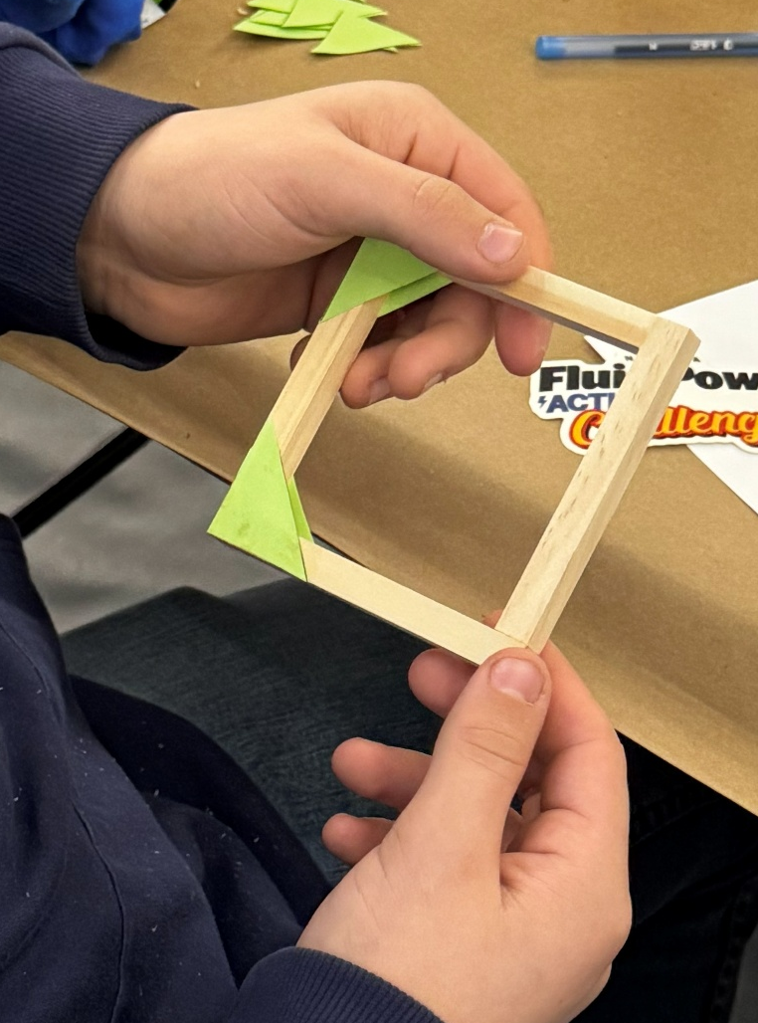
Using Wood Glue & Paper Gussets
1
2
3
4
5
Add a small amount of glue to the plastic cup.
Use stir-stick to apply a thin dab of glue to area where two pieces of wood will connect.
Cut-out the green paper gussets as needed; these will add strength to the glued wood.
Use a thin layer of glue when applying the GREEN PAPER triangular gussets; too much will soak the paper.
Position the gussets on the glued sections and let the assembly dry.
Notes:
EXPLAIN & SHOW HOW TO APPLY WOOD GLUE.

Slide 10
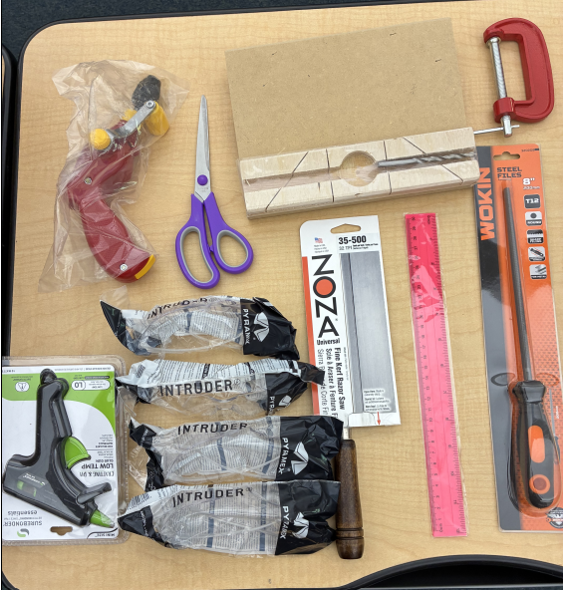
Hand Tool Kit Content Overview
Tool Kit Contents | Quantity
Safety Glasses with clear lens (1 per student) | 4
Acrylic Ruler (1/8-inch divisions) | 1
Scissors (1 pair) | 1
Bench Hook / Miter Box (double-sided, 3/8-inch slots) | 1
C-Clamp (3-inch) | 1
Kerf Razor Saw | 1
Pistol Grip Drill (store drill bit in handle compartment – see yellow door) | 1
Wood Drill Bit 3/16-inch (brad point) – Packed in Miter Box Slot | 1
8-inch Round File with Handle (1/4-inch diameter) | 1
Mini Low-Temp Glue Gun 10W – Tool for Challenge Day; Glue in Challenge Kit | 1
Reminder: You Will Need Your Tools on Challenge Day!
Notes:
Have teams double check the contents of their tool kits
Walk through the Tool Kit; invite volunteers & educator walk around and assist team in need of help

Slide 11
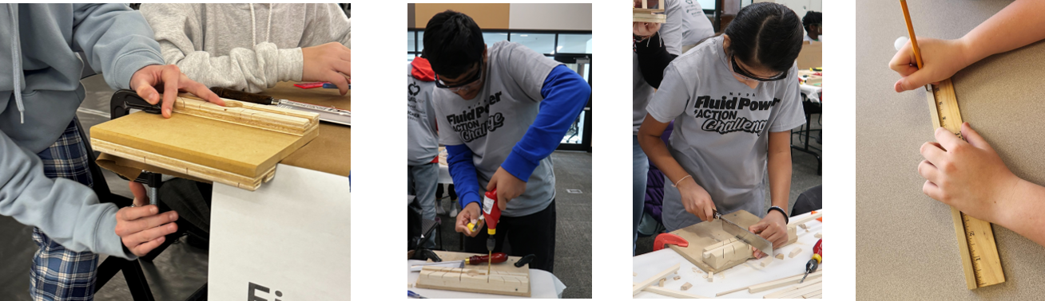
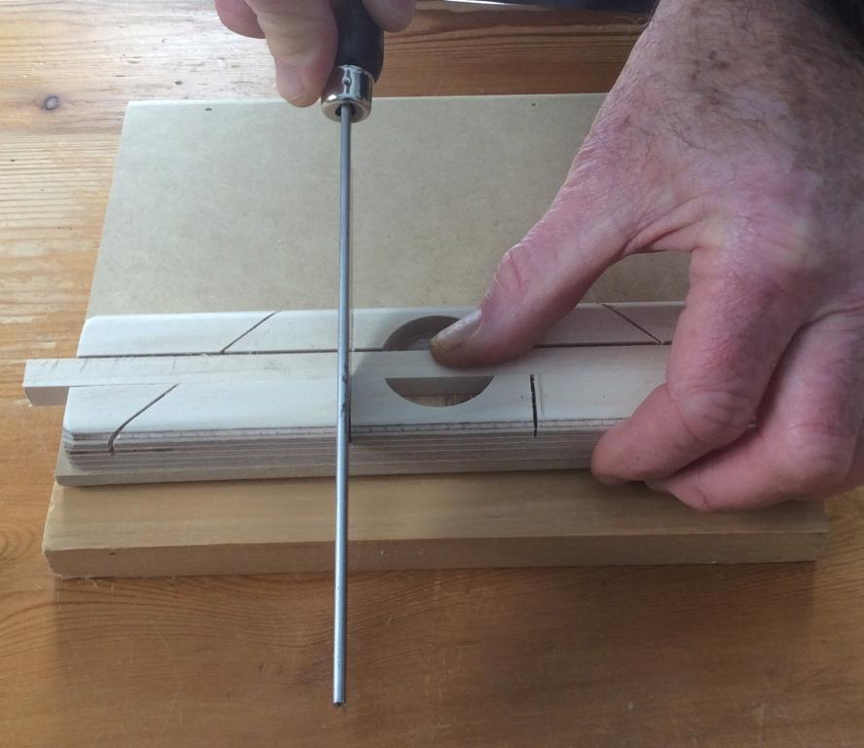
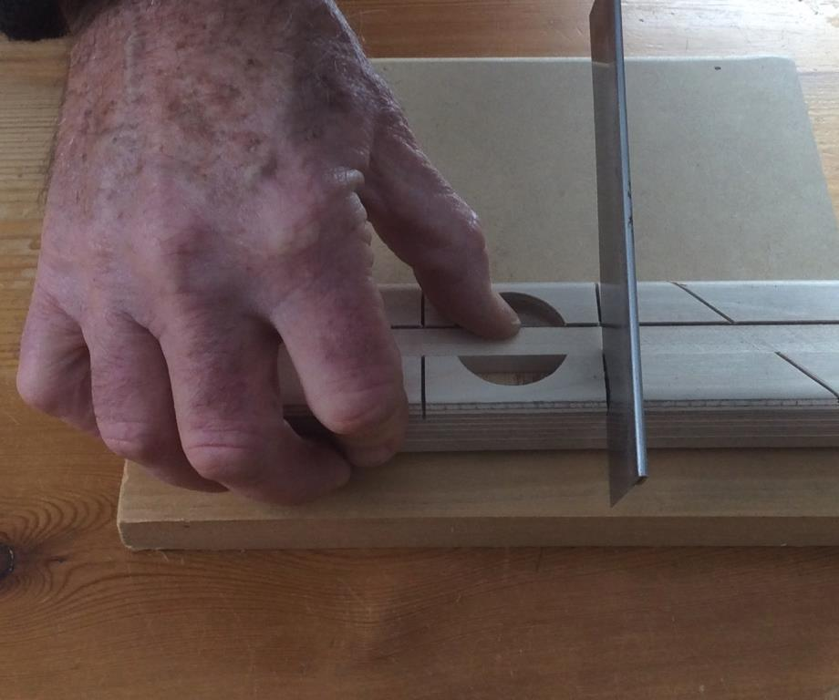
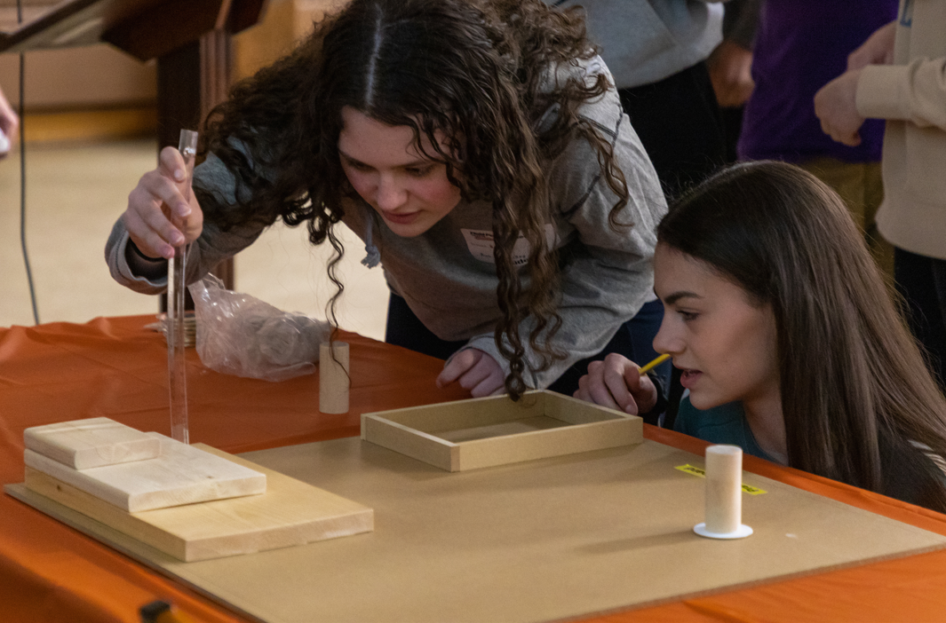
Hand Tool Demonstration
Right Hand Use
Left Hand Use
Notes:
Miter Board and C- Clamp -
The miter board is double sided and slotted. The slots are for holding wood and syringes during cutting, drilling, filing
C-clamp is used to secure the miter board to the table as shown. Demonstrate how the C-Clamp works, how the Miter board fits onto the table
8” File-
no photo available
Demonstrate how it works by filing a corner or edge of wood OR enlarging a hole (like the hole in the base block for the rotator peg)
Kerf Razor Saw –
Demonstrate how to make straight and 45-degree angled cuts using the miter board and a piece of wood
Ask volunteers and teachers to walk around and confirm teams understand
Ruler –
Remind them to measure from the black line at the beginning of the ruler (opposed to the physical end of the ruler)
Remind them that there are eight 8^{ths} in 1 inch; show them where the 1/8” mark is located
Ask volunteers and teachers to walk around and confirm teams understand
Drill – see next slide

Slide 12
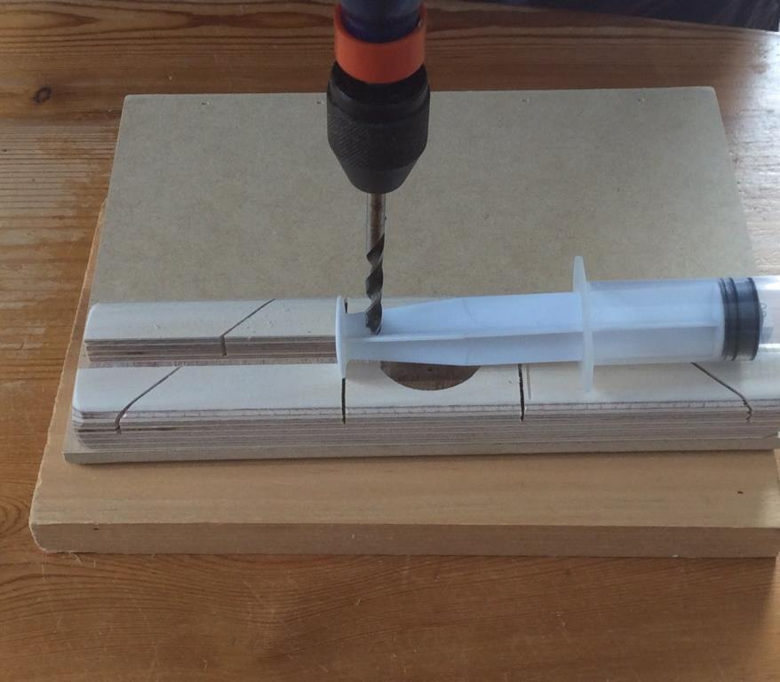
Hand Drill Demonstration
How to Drill into Syringe Plunger
Secure syringe in Miter Board by inserting the flat plunger head into a slot (see YELLOW ARROW for Example)
Keep the drill upright, steady, and push down for leverage
Press the drill bit into the plunger body and turn the hand-crank forward to start drilling.
To remove the drill bit from the hole, rotate the crank in the same direction and pull up.
Notes:
Hand Drill –
A NEW drill is packed with the handle / crank on backwards. Detach the handle; flip-it, and re-attach it so the drill can be cranked / used
Demonstrate how the chuck works by opening the chuck, loading the drill bit (tip up), tightening the chuck
Demonstrate how to safely use the drill on the Miter Board by putting a piece of wood into the long slot and drilling into the wood
Ask volunteers and teachers to walk around and confirm teams understand

Slide 13
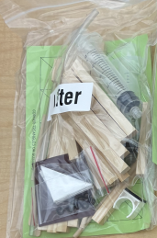
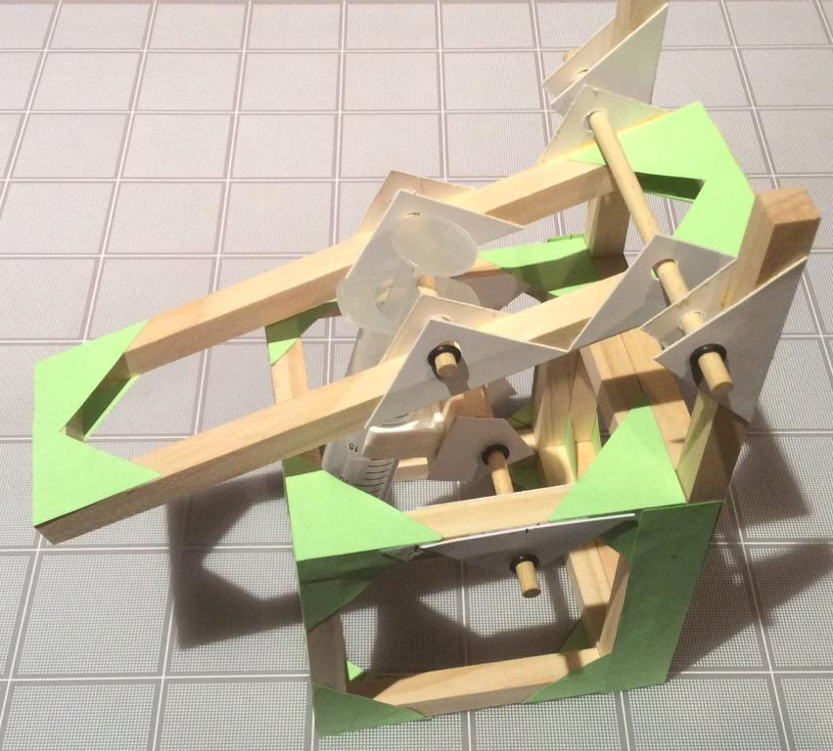
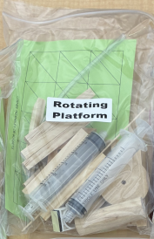
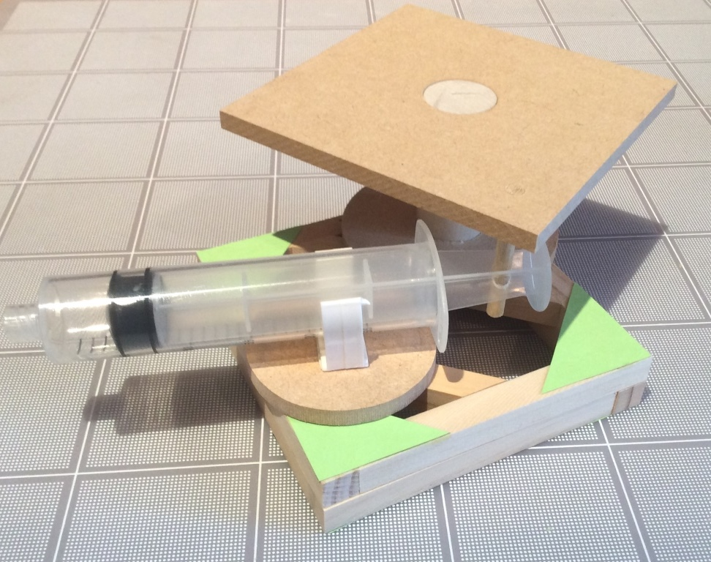
Kit Build Exercise Overview
Exercise #1: Cube & Lifter Kit Build
Exercise #2: Rotating Platform Kit Build
Teams need….
Cube & Lifter Instructions (Includes Parts List & Cube Assembly Tips)
Rotating Platform Instructions (Includes Parts List)
Tools: ruler, scissors, and safety glasses from the Tool Kits (leave the rest in the kit)
Wood glue
Notes:
Printout the “Cube & Lifter Instructions – Community Wide & School Workshop Day” document for each team.
Printout the “Rotating Platform Workshop Kit Instructions – In School” document for each team.

Slide 14
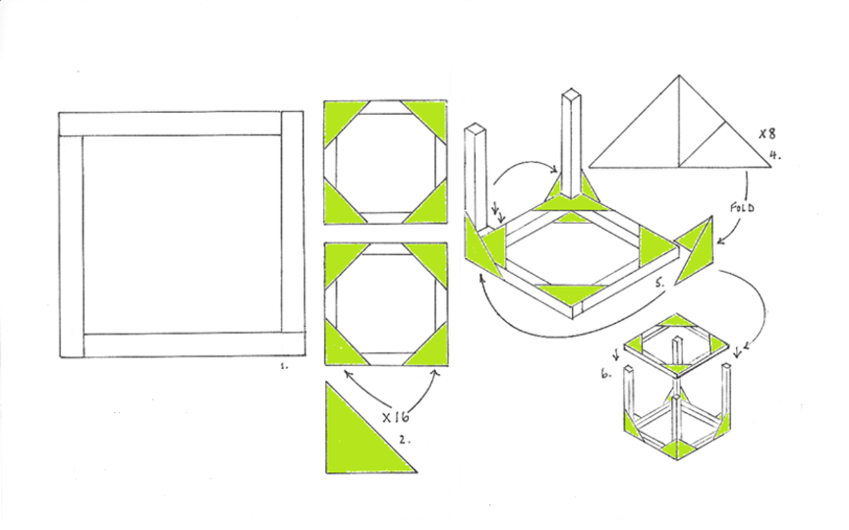
Making the 4-Inch Cube

Slide 15
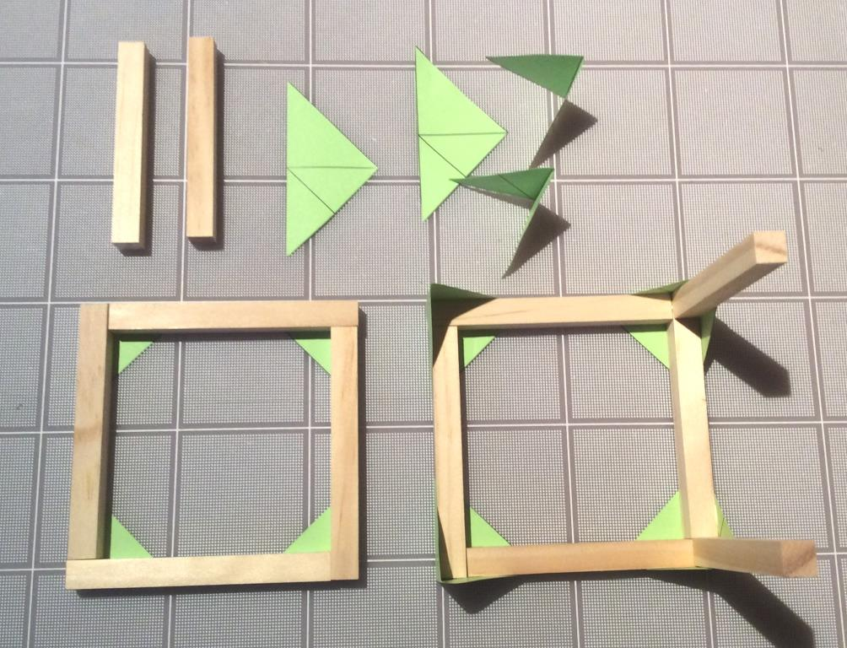
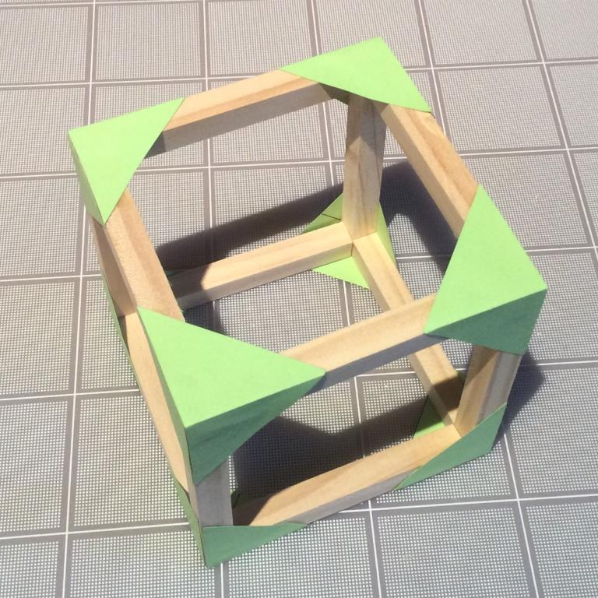
Making the 4-Inch Cube
Notes:
OPTIONAL: print out the “Six Process Step – Cube Wrap” document and allow the teams to glue each step to the sides of their finished cubes.

Slide 16
Build The Lifter

Slide 17
Build the Rotating Platform

Slide 18
Documents Needed
Rules for Challenge Day
The Challenge Scenario - Waterfall Drop Zone
Challenge Rubric
Portfolio Checklist
Portfolio Template
Iso - Ortho Views illustrated

Slide 19
Maximize Team Points
Design and build a strong and stable machine
Portfolio preparation:
  A detailed outline of each team member’s participation in the production of the portfolio and planned production of the device
    Think about your team – who is good at what?
    Think about the amount of time you have to design and build a prototype and record the process in your portfolio
  At least 3 illustrations of initial design concepts of possible device
  Detail helps you think about the connecting parts!
  A list of materials used from the Workshop Kit including dimensions
  Record the parts you use and their dimensions (important!)
  List of alternative / other materials that would have been useful AND the reasons why they would have been useful
Notes:
Next slides cover the strong and stable machine.

Slide 20
Machine Construction:
Structural Strength
Weight
Weight
Glue
Applied
Box A
Box B
GROUND
Which box (A or B) is a more structurally sound Design….and Why?
What else can go wrong and how can your team improve it?
Notes:
Answer #1 – Box B is better because the TOP segment of wood rests on the left and right pillars. Option A is weaker because the TOP segment is NOT resting on the left and right pillars…meaning the wood glue is holding 100% of the weight.
Answer #2 – in both options, the TOP segment of wood is ONLY held in place with wood glue. Extra wood support and/or paper gussets can help.

Slide 21
Machine Construction Tips
Structural Strength Continued
Green Paper Gusset
Weight
Weight
Glue
Applied
FORCE
FORCE
Box A
Box B
Wooden Cross Bar
GROUND
In this example, the construction of BOTH boxes (A & B) is identical
What do you observe AND what are the “pros and cons” of each?
Which option might be a more structurally sound design and why?
Notes:
Answer #1 – Listen for…FORCE has been added. Box A uses green paper gussets and glue. Box B uses a structural cross-bar without gussets (assume the cross—bar is secured to the box).
Answer #2 – AN ENGINEER CAN HELP with the answers…but the may each be equally sufficient for their appropriate application. One solution may not fit all applications OR design needs.

Slide 22






Machine Construction Tips
Structural Stability
Load =
2 lb.
Pivot Shaft
Arm Weighs 1 lb.
Base Weighs 1/2 lb.
GROUND
Any concerns with this structure? Let’s see what will happen in the next slide
Notes:
Let them think a bit and move to the next slide

Slide 23
Machine Construction Tips
Structural Stability
Pivot Shaft
Arm Weighs 1 lb.
Load =
2 lb.
Base Weighs 1/2 lb.
GROUND
GROUND
Why did the device tip over
How could your team prevent this from happening?
Notes:
Answer #1 - Listen for these answers:
The 2-pound load and 1-pound arm are heavier than the ½ pound base, so the device tipped over
The 1-pound arm extends a good distance past the edge the base that weighs a ½ pound…meaning the heavy arm causes a weight imbalance that helps pull over the base
Answer #2 – Listen for these answers:
A counterweight…counter to the 2-pound load and 1-pound arm….would help prevent the base from tipping over
A different design could help….(you may need an engineer to help interpret unique answers)

Slide 24
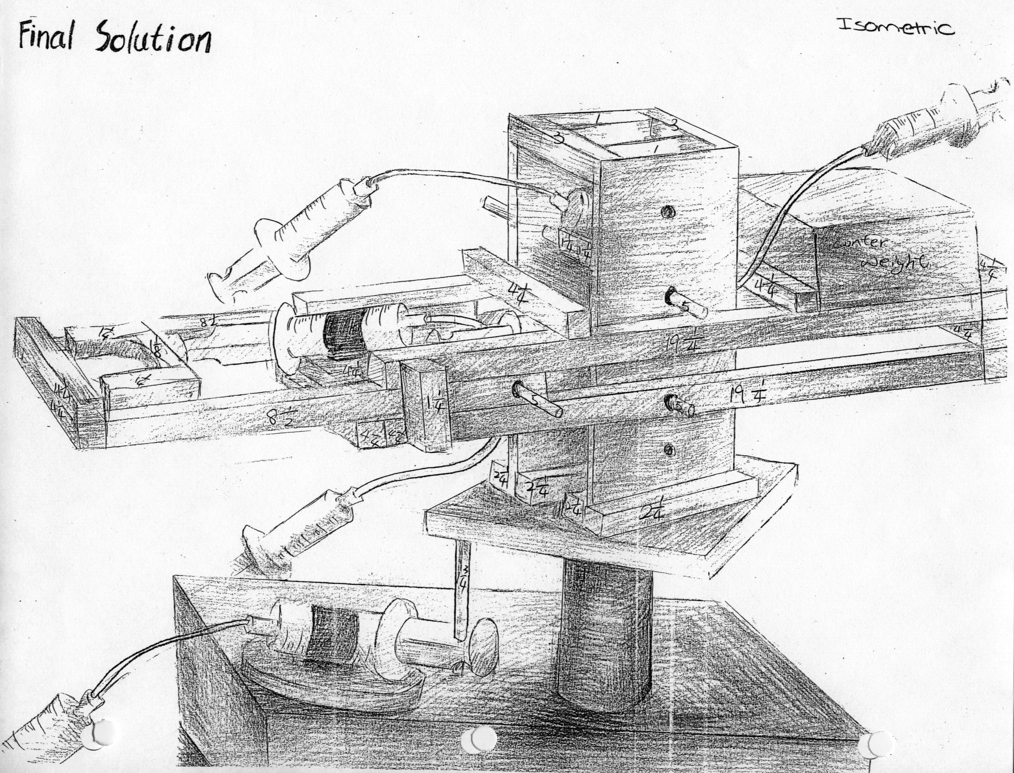
Placement of Hydraulic or Pneumatic Systems
As a team, decide on the type of fluid power (hydraulic or pneumatic) to use and where to place the piston-syringes and hoses.
Strategically place the actuating pistons on your machine to maximize levered movement.

Slide 25
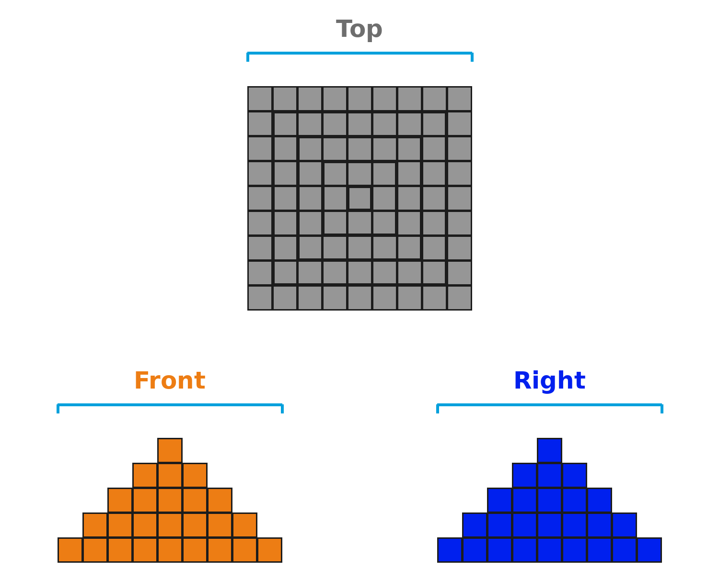
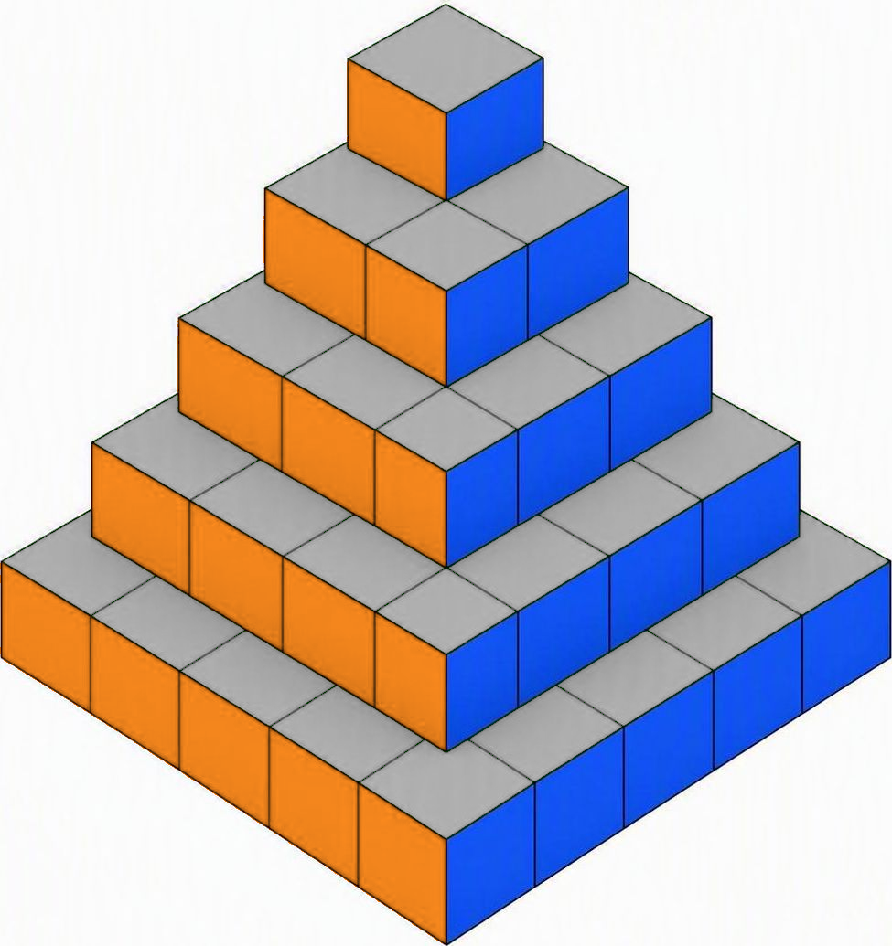
Portfolio Orthographic & Isometric Drawings
Orthographic Projection
Isometric View
Orthographic projection describes an object through separate top, front, and right views drawn true-to-scale for dimensioning and manufacturing.
Isometric view combines all three axes into one 3D pictorial. Each axis is color-coded — grey for top, orange for front, blue for right.

Slide 26
Team Portfolio & AI Use
AI use is not required.
Teams that choose to use AI will be instructed to use it as an investigative tool with the expectation that the portfolio demonstrates original thought and meaningful learning.
Use AI in a purposeful manner that reflets the team’s reasoning, content ownership, and insights.
Teams are not allowed to use AI (or agents) to create the machine design or generate the portfolio.
A team using AI should not automatically receive high scores.
A team that does not use AI should not be penalized for not using the tool.
During the Challenge Day interview session, teams must inform the judges if AI was used. If so, share / explain what prompts were used and how they informed the decisions made for your machine and portfolio.
Hosts, organizers, educators and judges - refer to the Judges’ Rubric & AI Use document for areas likely to include AI generated responses.
Notes:
Hosts / organizers – this is your event; meaning you make the final decisions about Artificial Intelligence usage and scoring.

Slide 27
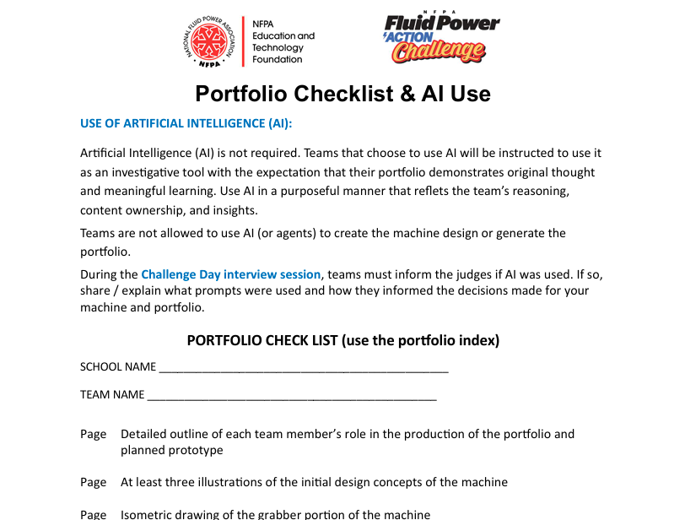
Portfolio Template & Checklist
Team Portfolio Template Serves 3 Uses:
  Teams document their prototype development and use it to capture machine build instructions;
  Use it on Challenge Day to re-create the working prototype;
  A good portfolio can help the team earn points.
Team Portfolio Checklist:
  Helps identify content to include in the portfolio
  Serves as the portfolio’s a table of contents
Notes:
Download and share the Portfolio Template with the teams. Visit the In-School Workshop Day Resources section of the Fluid Power Action Challenge web pages.
Download and share The Portfolio Checklist, which informs teams of the minimum contents to include in the portfolio. The Portfolio Checklist also serves as the portfolio’s table of contents.
Consider showing the teams the example middle school portfolio example (download from the In-School Workshop Day Resources)

Slide 28

Challenge Board Waterfall Drop Zone
Teams have 2 MINUTES to pick up the wooden cylinder (peg) from the start position and move it to any of the zones.
To earn points, wooden cylinders (2-3/4-inch long x 1-1/4-inch diameter) must be moved without being dropped and placed upright on the board.
Points:
  Top Tier = 3 points
  Middle Tier = 2 points
  Bottom Tier = 1 points
Base of your machine must sit INSIDE the rectangular “footprint area” (see image)
3 Pts.
Footprint Area for Machine Base
2 Pts.
1 Pt.
Start Position for Cylinder / Peg
Notes:
Tips for Hosts regarding Challenge Day and number of competition boards….each team has 2-minutes on the competition board. If you are ONLY using one competition board, you will likely be able to have 20-25 teams compete in 60 minutes (including team transition time)….60 min / 2-min = 30 teams. Yet, factor in about 5-min of total transition time for the 30 teams.
Take the following steps when building your Challenge Day Agenda; determining competition board needs; and determining your competition board judging needs. 1) Based on the total number of teams, determine your competition timing, which will impact timing for score tabulation, award ceremony, and departure. If timing is tight (e.g., schools need to depart by 2PM), use more competition boards, allowing multiple teams to compete simultaneously on each of the boards. Reminder each competition board needs 3 volunteers (peg setter, time-keeper, and score keeper). Use educators if you run out of volunteers.
Suggested Competition Board Quantities:
Use at least 2 boards if you have 25 teams or less
Use 3-4 boards if you have 26 – 40 teams
Use 5-6 boards if you have 41 – 60 teams
Use 7-8 boards if you have 61-80 teams
Use 9-10 boards if you have 81-100 teams

Slide 29
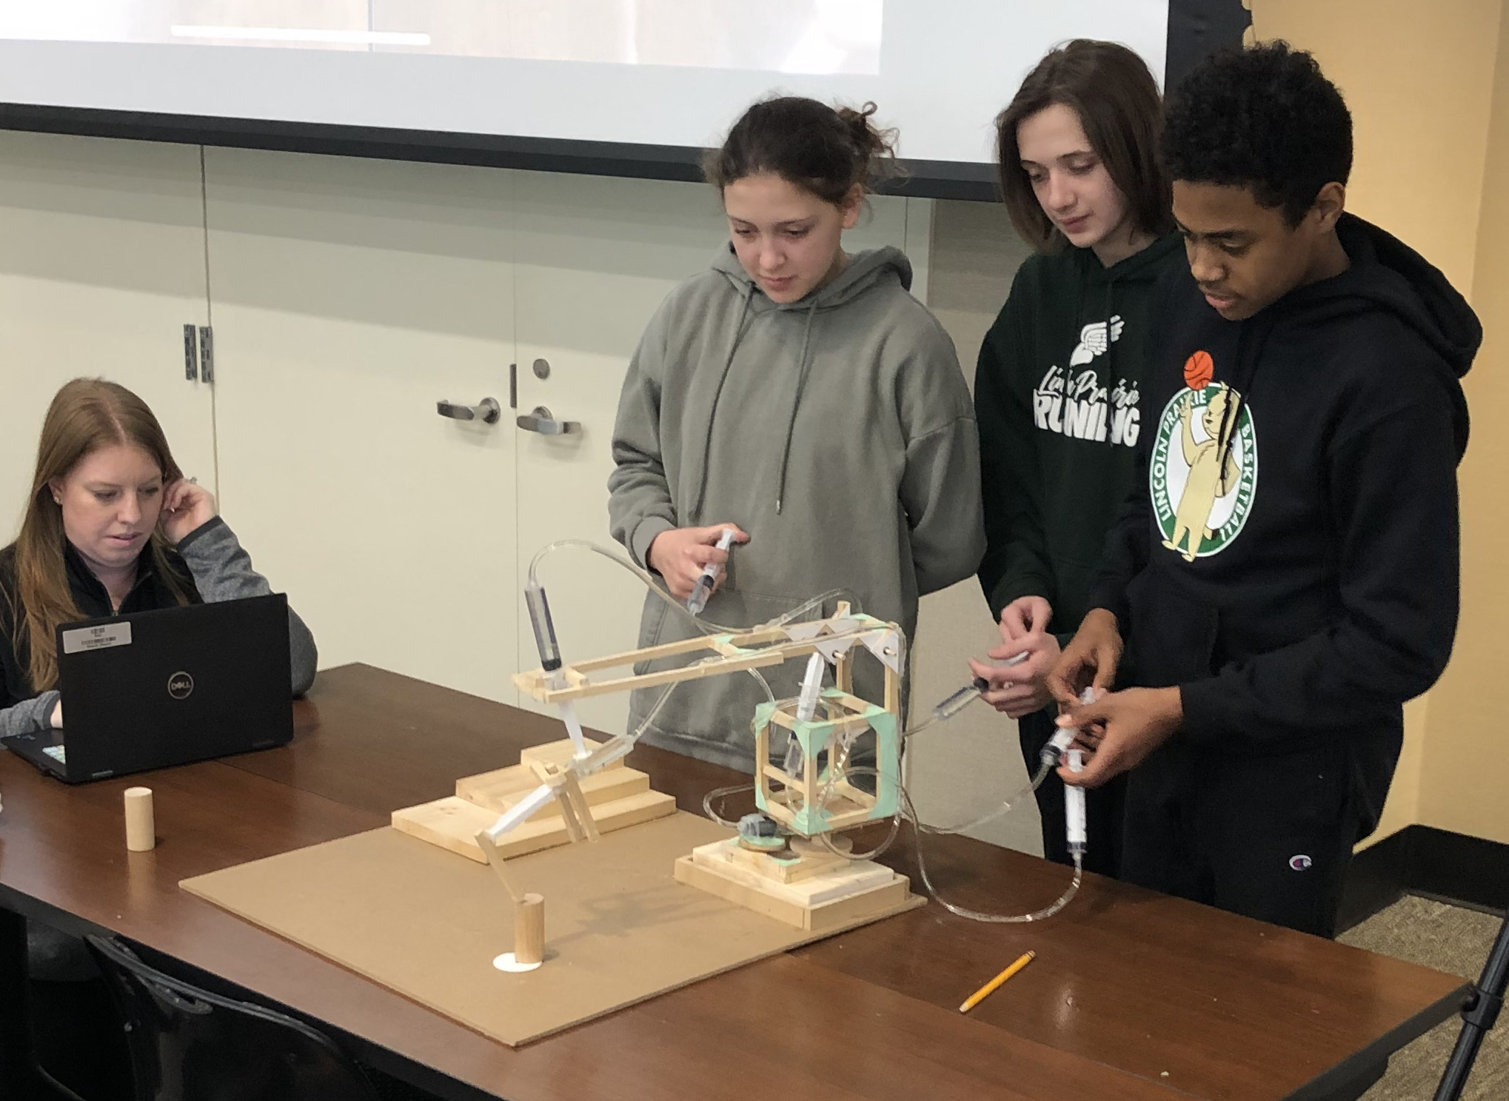
Waterfall Drop Zone Challenge Board
This is an EXAMPLE of a completed fluid power machine positioned properly on the Waterfall Drop Zone Challenge Board.
Move the cylinder/peg from the starting point to any of the three zones during the 2-minute competition.
To earn points, the wooden cylinder (2-3/4” long x 1-1/4” diameter) must be moved without being dropped and placed upright in a zone.

Slide 30
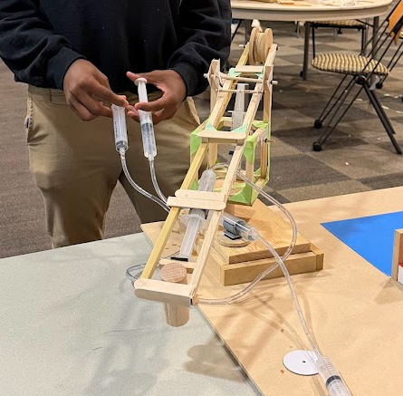
Example of a Finished Machine
Lifter
Syringes
Cube
Rotating Platform
Base

Slide 31
Fluid Power Action Challenge Rules
Use of Artificial Intelligence (AI):
  Use AI in a purposeful manner that reflets the team’s reasoning, content ownership, and insights.
  Teams are not allowed to use AI (or agents) to create the machine design or generate the portfolio.
Demonstrate SAFE behavior; unsafe behavior can hurt you, the team, and others.
Use only the materials and tools provided in your kits, outside materials and tools are not allowed.
All movements of the device MUST be controlled using fluid power.
If a team moves / powers its machine by hand or IN ANY OTHER WAY, the team will receive zero points for its “moving object” scores on the Challenge Board.
If a team creates a machine that only works when stabilized by hand(s), only 50% of the Challenge Board points will count.
If your machine breaks during the 2-minute competition, the team can attempt to repair it during the remaining time, but all subsequent “moving object” points will be reduced by 50%.
The Judges’ decisions are final.

Slide 32
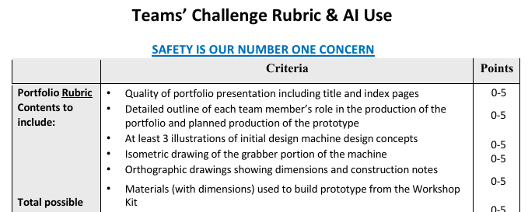
Challenge Rubric & Team Evaluation
The Challenge Rubric identifies how your team (and portfolio) will be evaluated.
Notes:
Download and provide each team with 2-printed copies of the Team Challenge Rubric today.
Walk the teams through the Team Challenge Rubric. The host and educator(s) should share any adjustments to the evaluation process.

Slide 33
Competition Discussion
How many Team Portfolios does each team need to bring to Challenge Day?
Why do the destination tiers on the Challenge Board have different point values?
What if machine only works when stabilized by hand on the Competition Board?
How much total time does each team get on the Competition Board?
What tools / materials can you use to build your device on Challenge Day?
Why is the portfolio so important?
Notes:
Answer #1 – Each team must bring 2 copies of the portfolio on Challenge Day. One is turned in to be judged; the 2nd is used by the team to recreate the working prototype machine
Answer #2 – Each tier represents a different level of difficulty, meaning tiers / zones with higher points are more difficult to reach than tiers / zones with lower points.
Answer #3 - If your team manufactures a device that only works when it is stabilized by hand(s) then only 50% of the ‘moving object’ score will count.
Answer #4 – Each team has 2 minutes to score as many points as they can
Answer #5 – Teams are only allowed to use the tools and materials included with your kits; no outside materials or tools are allowed.
Answer #6 - The Portfolio serves 3 purposes: 1) Document the Workshop Day prototype development; 2) use to capture the team’s build instructions used on Challenge Day; and 3) portfolio helps teams earn points!

Slide 34
Teamwork & Work Habits
Successful teams will:
  Work together according to a time-line
  Assign & divide tasks
  Plan their work & work their plan
  Complete tasks in parallel
  Leverage individuals' strengths
  Won’t “mess with” other teams

Slide 35
The FPAC Process
Event Objective - Teams design and build a fluid power machine using only the supplied tools and materials to score as many points as possible on Challenge Day, which includes a 2-minute timed competition on the Challenge Board.
Deliverables – Two (2) copies of the portfolio
Challenge Day:
  Bring two (2) copies of the Team Portfolio; turn-in one for judging and use the other to reconstruct your working prototype machine
  Bring your tool kit
  Teams will receive a Challenge Kit, which they will use to recreate their working prototype machine
  Challenge Kits contains all the materials you need, including two extra 20cc syringes, 6ft. of extra tubing, and some glue sticks for the hot-glue gun

Slide 36
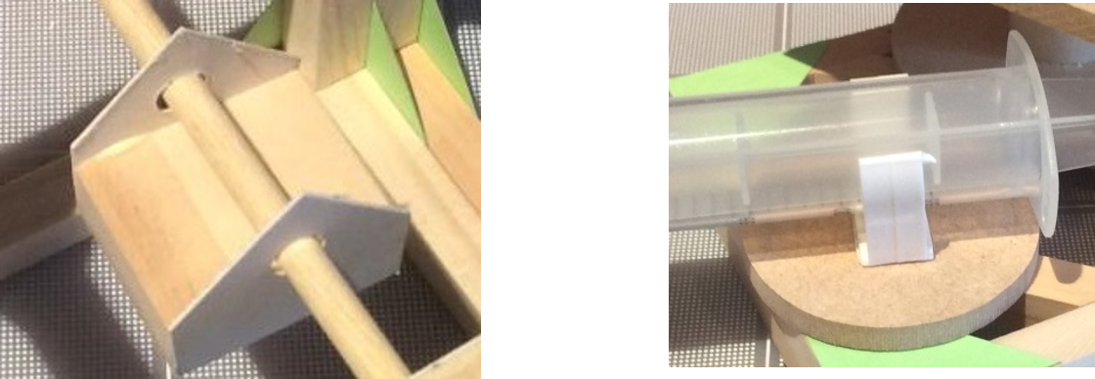
Using Piston Syringe Clips
#1 reason devices fail is because the clips are not fixed correctly to the device.
A platform must be used to accommodate movement, and the clips must be secure.
Use the gray clips where a greater resisting force is required. Plan your clip location before fixing them to the device. Using hot glue is not a good alternative.

Slide 37
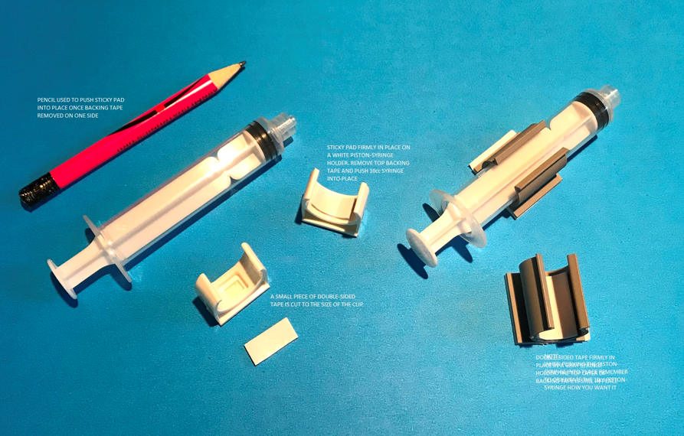
White & Grey Piston Syringe Clips
Large Gray Clips: use a piece of double-sided tape cut to the size of the clip.
Peel off one (1) side of the tape and insert firmly into clip.
Small White Clips: alternatively use the smaller white clips provided.
NOTE: one of the 10cc piston-syringes has a hole in the plunger.
The Workshop kit and Challenge kit each contain syringe holders.
Syring holders have a “one-time” sticky pad on its base and must be pushed firmly onto a paper, plastic or wooden surface to adhere sufficiently and hold the 20cc or 10cc piston syringe.
A double-sided sticky pad can be used with it, if a larger area is required.

Slide 38
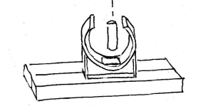
Syringe Clip Sticky Pad Trouble
If Sticky Pad Holding Syringe Clip Fails
Drill a hole in the base of the clip and a second hole in the piece of wood directly below the clip.
Place the clip over the hole in the wood; insert a dowel rod segment into the hole ensuring it goes into the 2nd hole, too.
Secure dowel rod segment with wood glue to hold the clip.

Slide 39
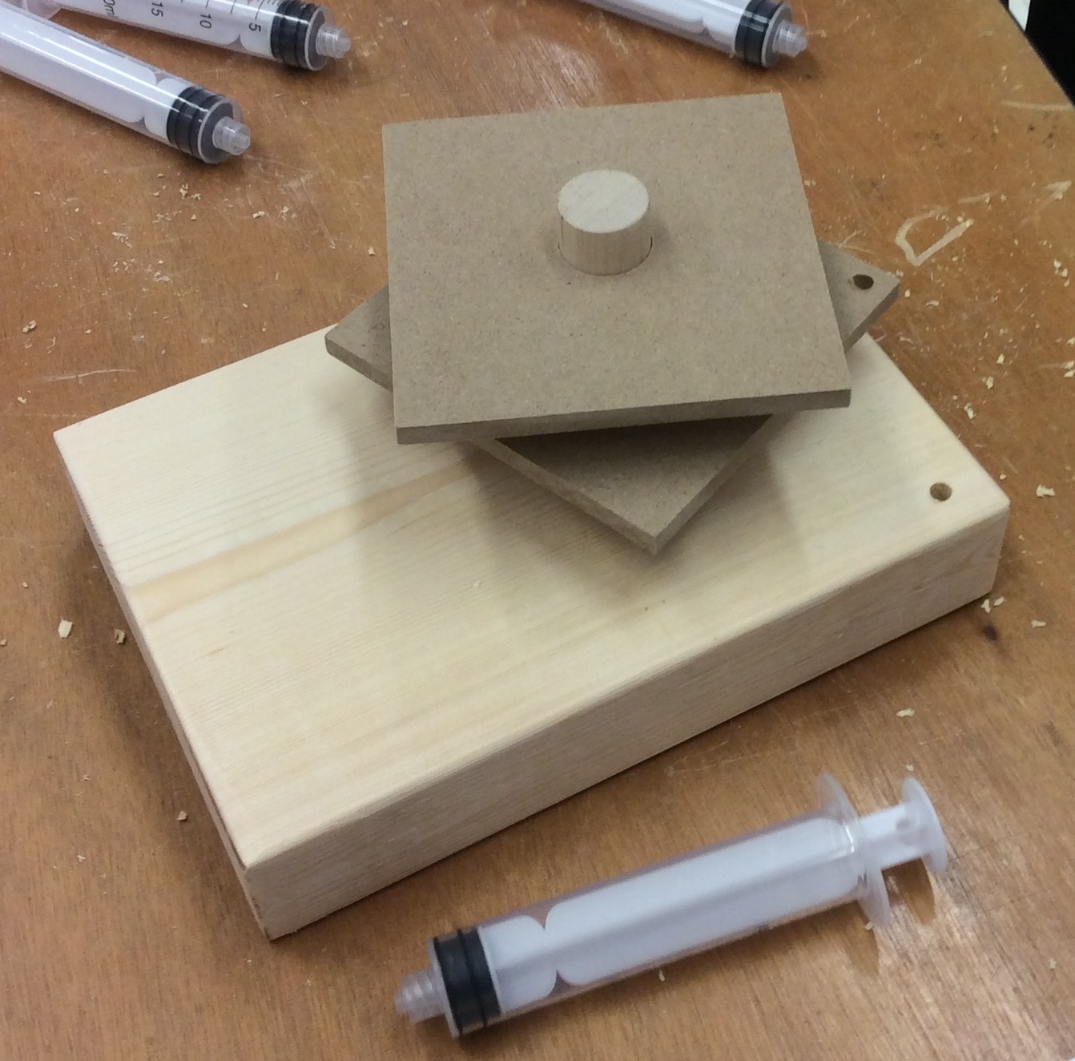
Base Block & 4-Inch Squares
Workshop and Challenge Day Kits contain a large wooden base with an off-set (non-centered) hole for a large diameter dowel segment
Block is designed to fit into the “footprint area” of the competition board can be serve as a stable base for your machine
Teams may need to sand the dowel down to fit the hole OR enlarge the hole with the file to fit the large dowel. The large dowel is designed remain snug (not rotate) in the base’s hole.
In the photo, two 4-inch squares fit onto the large dowel and can be used as part of a rotating platform. You may need to sand the large hole in the 4-in squares to help them rotate on the dowel
Attaching a piston (syringe) will help you move the squares

Slide 40
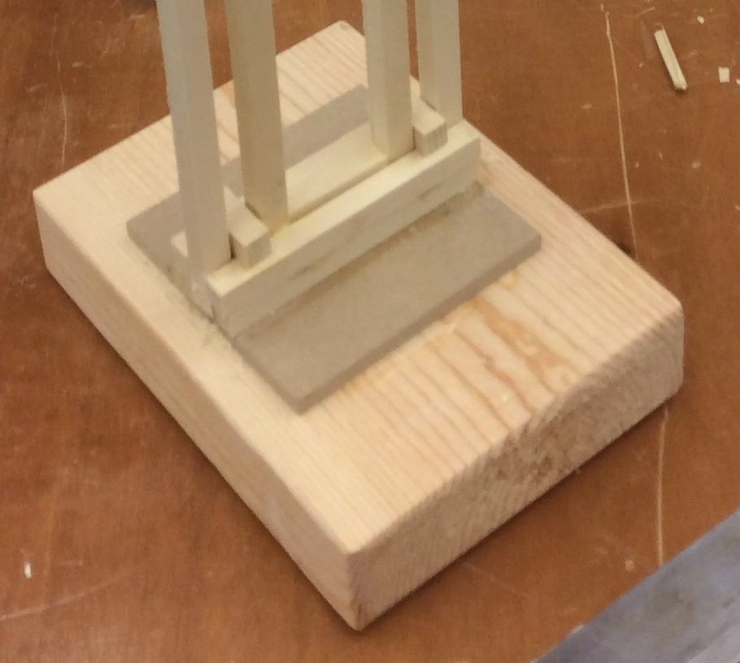
Alternative Use of Base Block
This photos shows how the large wooden base was used in a different way.
The large dowel is not used, but the base is still used for the machine’s foundation.

Slide 41
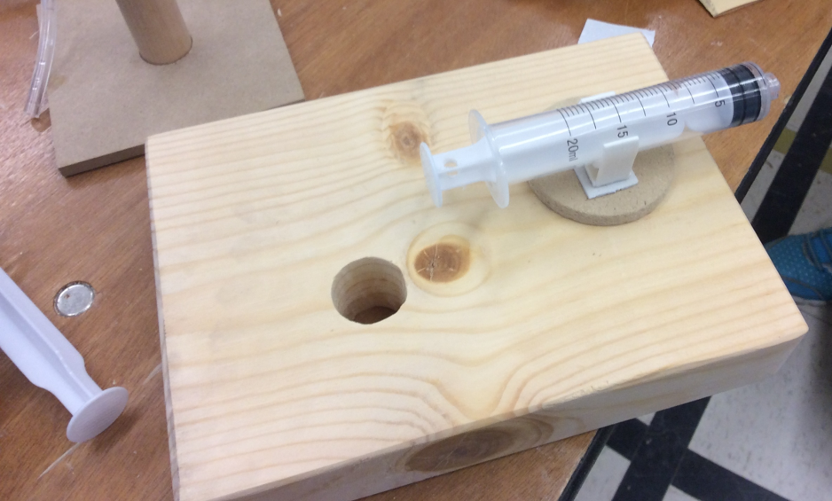
What’s Wrong With This Picture?
The arrangement in the picture may have potential problems. Why?

Slide 42
Prototype Machine Construction Tips
Create a plan for researching, designing, and building your working prototype
Measure twice, cut once; accuracy is important
Using Wood Glue
  Less is more!
  Excessive glue takes longer to ‘set-up’ and does NOT result in a stronger joint
  Use the stir-sticks to spread a think layer of glue on the contact surfaces
  Use paper gussets and structural members for strength
Think about structural stability and center of Gravity when building the machine
Understand how the piston-syringes are mounted

Slide 43
Behave Safely!
Safety is everyone’s responsibility!
Always wear safety glasses - even when not cutting, drilling, filing, or sanding
No Running, No Throwing, No Misusing the Tools, etc.
When sawing, drilling, filing or sanding…
  Ensure a miter box securely clamped down with the C-Clamp
  Ensure each workpiece is secure & stable
  Ensure your hands an fingers are out of harms way
  Wipe sawdust, don’t blow
The tip of the low-temp glue gun is HOT. Do not touch it.
Questions?
Notes:
The Hot Glue Guns may be used on Challenge Day…but not on Workshop Day or during the time students return to the classroom to research, design, and build the working prototype.
Glue gun sticks will be packed in the Challenge Day kit boxes

Slide 44
Preparation, Planning & Organizing
SAFETY is EVERYONE'S number #1 concern
ALL motion must be controlled by fluid power
USE your materials wisely
DOCUMENT everything in your portfolio
All materials to build device are provided
Bring your tool kit to Challenge Day
Use your time efficiently
Work well as a TEAM!

Slide 45
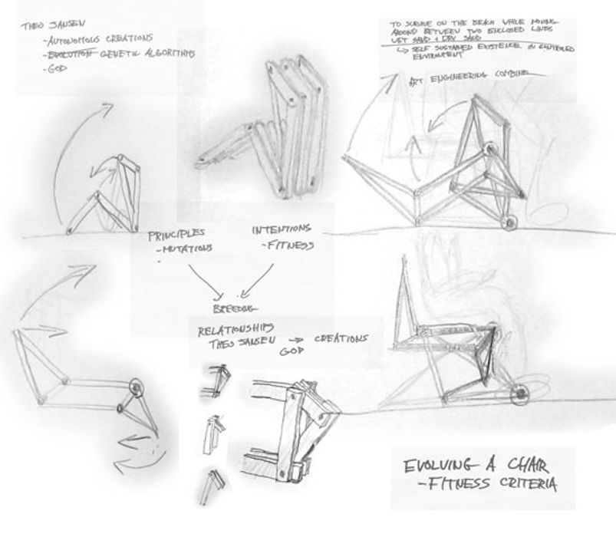
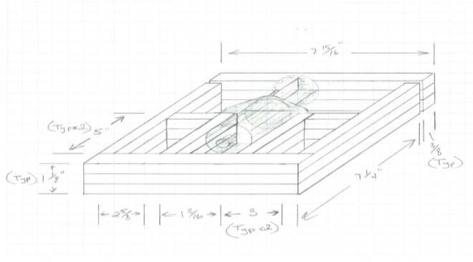
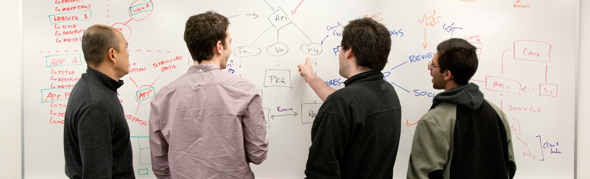
Sketching & Communicating Ideas

Slide 46
Team Task Examples
Who will be responsible for These?
Identify tasks and milestones.
Read project rules
Research clamping mechanisms
Sketch ideas for clamping mechanisms
Research rotating mechanisms
Sketch ideas for rotating mechanisms
Research rotating mechanisms
Build prototype mechanisms
Sketch whole robot design
Build a whole prototype
Practice challenge activity
Read portfolio scoring rubric
Generate final sketches of design for portfolio
Write a description of the principles of strength and stability
Write an explanation of the chosen location of your syringes
Have writing reviewed by a mentor
Assemble all portfolio elements into a final report

Slide 47

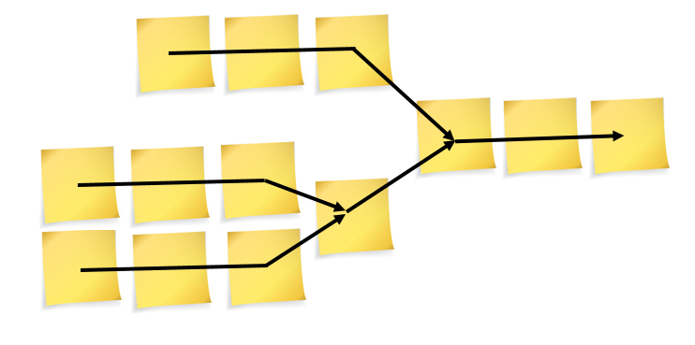
What to Do Now?
Identify 3 tasks or milestones
Lay out the schedule
Choose dates for your milestones

Slide 48
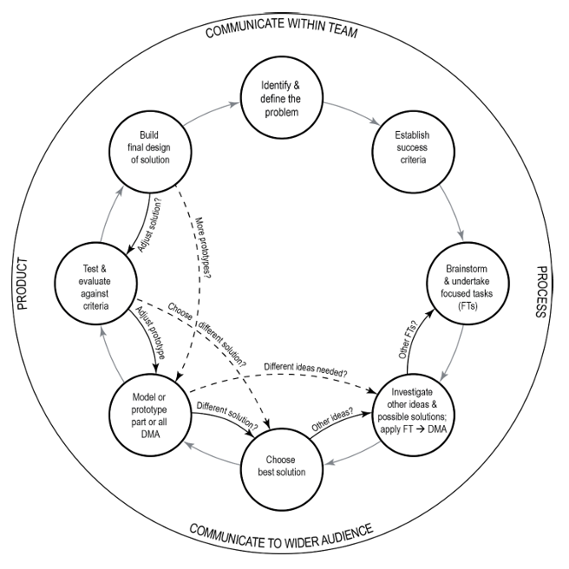
Prototype Machine Design Process
High Level Summary
Identify & define the problem
Establish success criteria
Brainstorm & undertake focused tasks
Investigate other ideas & possible solutions
Choose best solution
Model or prototype parts of (or all) possible solutions
Test and evaluate against the established success criteria
Build the final design and solution

Slide 49

Appendix

Slide 50
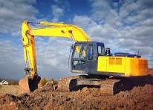
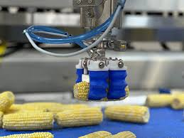
Fluid Power Overview
Fluid
Liquid
Gas
Water
Hydraulic Oil
Compressed Air
Nitrogen
Hydraulic Systems Use These
Pneumatic Systems
Use These
Notes:
Fluid power (hydraulic and pneumatic) technology is used to generate, control and transmit power in a variety of applications that you see in the world…like airplanes, automobiles, rollercoasters, and construction equipment
You can find fluid power components in aerospace, agriculture, automation, construction, energy, entertainment, forestry, food processing, lawn & garden, marine, material handling, medical devices, mining, oil & gas, packaging, transportation and more.
Water and hydraulic oil are primarily incompressible pressurized liquids, allowing the fluids to generate high force in a hydraulic application like excavator equipment
Compressed air and nitrogen are highly compressible, meaning they are not as strong as hydraulic fluids….but still great for specified pneumatic applications like automated “pick in place” food packaging applications

Slide 51


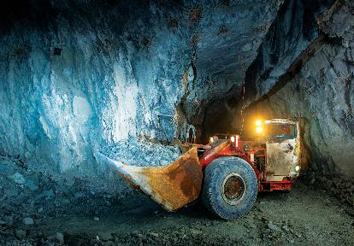
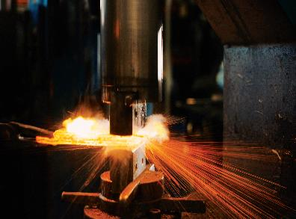

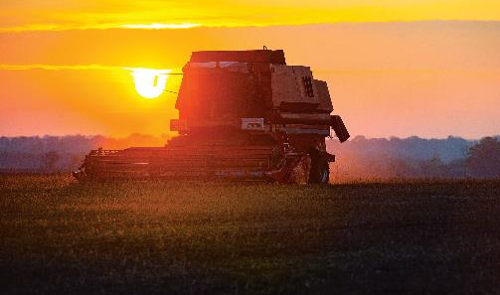

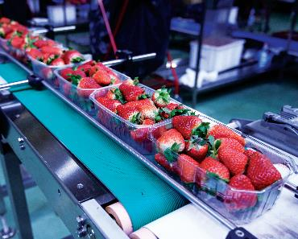
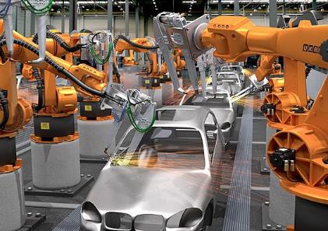
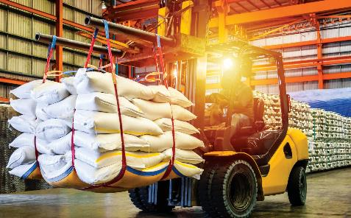

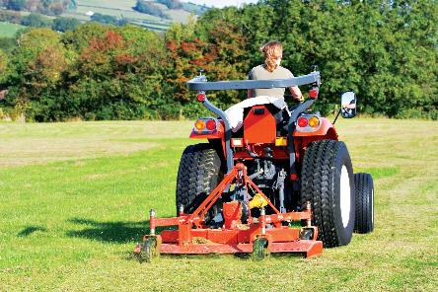
Industries Using Fluid Power
Aerospace
Construction & Mining Equipment
Metalworking
Power Generation
Cars and Trucks
Entertainment
Food Processing & Packaging
Agricultural Equipment
Material Handling
Lawn &
Garden
Equipment
Factory Automation
Biomedical

Slide 52
Fluid Power Career Examples
Sales Engineer sell complex scientific and technological products or services to businesses. They need extensive knowledge of the products’ parts and functions and must understand the scientific processes that make the products work.
Mechanical Engineers are one of the broadest engineering disciplines. Mechanical engineers design, develop, build, and test mechanical and thermal sensors and devices, including tools, engines, and machines.
Technicians help mechanical engineers design, develop, test, and manufacture mechanical devices, including tools, engines, and machines.
Mechanists set up and operate a variety of computer-controlled and mechanically controlled machine tools to produce precision metal parts, instruments, and tools.
Customer Service Representatives interact with customers to handle complaints, process orders, and provide information about an organization’s products and services.
Role | Average Salary (2023 Bureau of Labor Statistics) | Education
Sales Engineer | $116,000 | Bachelor’s Degree
Mechanical Engineer | $99,500 | Bachelor’s Degree
Technician | $64,000 | Associates Degree
Machinist | $53,180 | High School / Job Training
Customer Service Representative | $39,680 | High School / Job Training

Slide 53
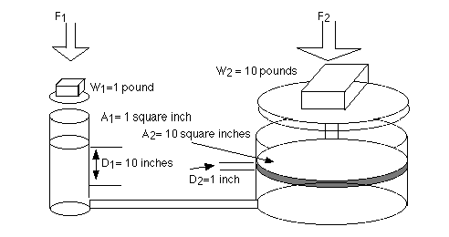
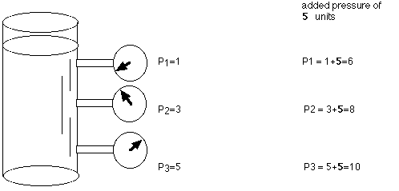
Pascal’s Law &
Mechanical Advantage
Example B
Example A
Source: NASA, Pascal’s Principle and Hydraulics, Carol Hodanbosi and Johathan G. Fairman, August 1996
Notes:
Pascal's law states that when there is an increase in pressure at any point in a confined fluid, there is an equal increase at every other point in the container.
Example A, the container contains a fluid, so there is an increase in pressure as the length of the column of liquid increases, due to the increased mass of the fluid.
If the container had an increase in overall pressure, that same added pressure would affect each of the gauges (see image)….and the liquid throughout… the same.
For example… gages P1, P2, P3 were originally 1, 3, 5 units of pressure, and 5 units of pressure were added to the system, the new gage readings would be 6, 8, and 10.
Example B, Pascal’s Law allows the forces to be multiplied….
The cylinder on the left shows a cross-section area of 1 square inch; the cylinder on the right shows a cross-section area of 10 square inches.
The cylinder on the left has a weight (force) on 1 pound acting downward on the piston (F1), which lowers the fluid 10 inches.
As a result of this force, the piston on the right lifts a 10-pound weight a distance of 1-inch.
The 1-pound load on the 1 square inch area causes an increase in pressure on the fluid in the system.
This pressure is distributed equally throughout and acts on every square inch of the 10 square inch area of the large piston.
Again, the larger piston lifts-up a 10-pound weight . The larger the cross-section area of the second piston, the larger the mechanical advantage, and the more weight it lifts.

Slide 54
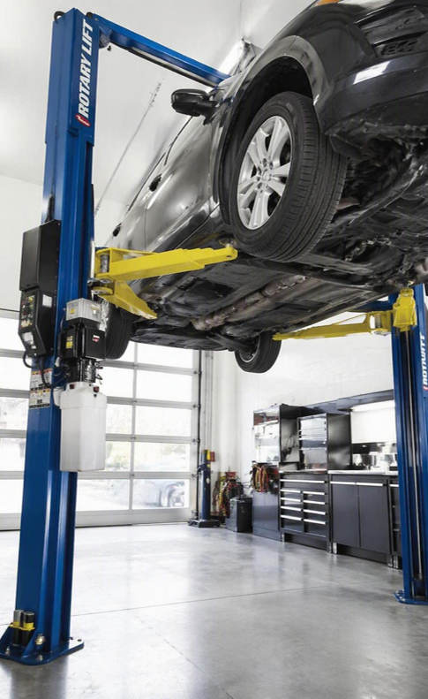
Pascal’s Law In Action
Real-World Example: Hydraulic Car Lift
The rule: When you push on a liquid trapped in a sealed container, the push (pressure) spreads out equally to every part of the liquid.
Big idea
A small push on the small piston becomes a giant push on the big one — so one person can lift a 2-ton car.
How the cart lift works:
1) A worker presses down on a small piston, squeezing the oil sealed inside a tube
2) That same pressure travels through the oil to a much wider piston under the car
3) The wide piston has more area, so the equal pressure turns into a much bigger force — enough to raise the car!

